Slide 1

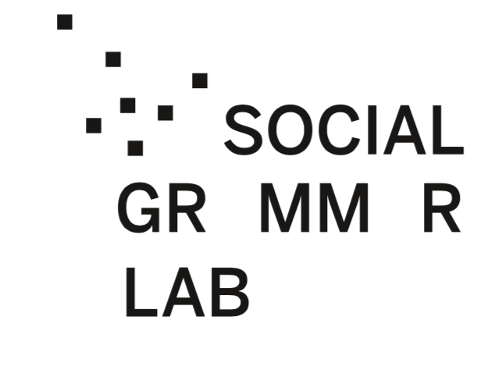


Linguistic Agency and Mobilization:
Persuasion in Political Discourse and
Action-Oriented Communication
Jan Nikadon, Marta Beneda, Marta Witkowska, Lejla Džanko, Paweł Jurek, Michał Olech, Tomaso Erseghe, Caterina Suitner, Magdalena Formanowicz
19th Annual Meeting of the Polish Social Psychological Society (2024)

Slide 2
How to mobilize / encourage others to act?
Sub-Questions
Do people who aim to encourage others “to do something” use specific linguistic devices?
Are such devices effective? (Is that communication understood by recipients according to the speaker’s intention?)

Slide 3
How to mobilize / encourage others to act?
Action Coordination [AC]
Requires ability to form shared representations of tasks/actions
a “cornerstone of social cognition”,
anables functional human interactions
(typically based on common goals).
Communication is crucial,
→ we explored linguistic factors involved in encouraging / mobilizing others
Ubiquity of AC →
possibility of universal linguistic components / devices that are clear for both message authors and recipients.
(persuasion-knowledge model, Friestad & Wright, 1994)
Notes:
The ability to form shared representations of tasks has been considered a “cornerstone of social cognition”, because it allows for functional human interactions often based on common goals.
For action coordination, communication is crucial, therefore we explored linguistic factors involved in encouraging/mobilizing others.
If is is so ubiquitous then the should be universal linguistic components that are clear for both authors and recipients
Do people who aim to encourage others to do something use specific linguistic devices?
Is that communication understood by recipients according to the speaker’s intention?

Slide 4
How to mobilize / encourage others to act?
Goal Pursuit Theoretical Framework
(Gollwitzer & Oettingen, 2012)
Action coordination requires
Action-setting: [“drive”]:
Establishing intention to achieve a goal;
Action planning: [“direction”]
Establishing concrete particularities of how to achieve it.
Ubiquity + Structure of AC →
Possibility of (potentially two) universal linguistic components / devices that are clear for both message authors and recipients.
Reflecting both aspects of AC

Slide 5
Action Orientation [AO] and Verbs
Pursuit of goals of primary importance to all organisms (Frith & Frith 2010);
Attention to agency of others (Abele & Wojciszke 2007);
General attentional bias towards cues of agency (New et al. 2007);
Multiple indicators of agency in language (Formanowicz et al. 2017);
Attentional bias towards those cues in language processing (Bornkessel & Schlesewsky 2006);
Verbs, as grammatical vehicles of action, are linguistic markers of agency (Formanowicz et al. 2017);
Verbs representing agency are both encoded in and decoded from language (Formanowicz et al. 2017).
Notes:
FIXME

Slide 6
Action Orientation [AO] and Verbs
Multiple indicators of AO (agency) in language (Formanowicz et al. 2017);
Verbs, as grammatical vehicles of action, are
Linguistic (grammatical) markers of agency (Formanowicz et al. 2017);
Verbs representing agency are both encoded in and decoded from language (Formanowicz et al. 2017);
Verb sentences more vivid and easy to imagine than noun sentences (Hansen & Wänke, 2010).
Notes:
FIXME
why cues of agency can be considered a good candidate for being recognizable both by the message author and the message recipient.
Found to be effective in persuasive communication
Verbs ™
Lets do Science

Slide 7
Action Orientation [AO] and Verbs
Multiple indicators of AO (agency) in language (Formanowicz et al. 2017);
Verbs, as grammatical vehicles of action, are
Linguistic (grammatical) markers of agency (Vigliocco et al., 2011; Formanowicz et al. 2017).
E.g., Girls were more likely to engage in science activities when encouraged with a verb (e.g., “Let’s do science!”) than with a noun (e.g., “Let’s be scientists!”). (Rhodes et al., 2019)
Notes:
FIXME
why cues of agency can be considered a good candidate for being recognizable both by the message author and the message recipient.
Found to be effective in persuasive communication
Verbs ™
Lets do Science

Slide 8
Action Planning [AP] and Concreteness
How to approach a given action (Liberman & Trope, 2008)
Imaginable qualities (Paivio, 1971, 2013)
Concrete utterances are:
Easier to remember than abstract ones
Enable faster and more in-depth information processing (Schwanenflugel & Stowe, 1989);
Elicit more engagement in readers (Sadoski et al., 2000).
Concrete speakers evaluated as more action oriented (Palmeira, 2015).
“How to engage in an action” rated as more concrete and action oriented than “why to engage” (Palmeira, 2015);

Slide 9
Action Planning [AP] and Concreteness
How to approach a given action (Liberman & Trope, 2008)
Concrete utterances are:
Provide imaginable qualities (Paivio, 1971, 2013)
Easier to remember than abstract ones
Enable faster and more in-depth information processing (Schwanenflugel & Stowe, 1989);
Elicit more engagement in readers (Sadoski et al., 2000).

Slide 10
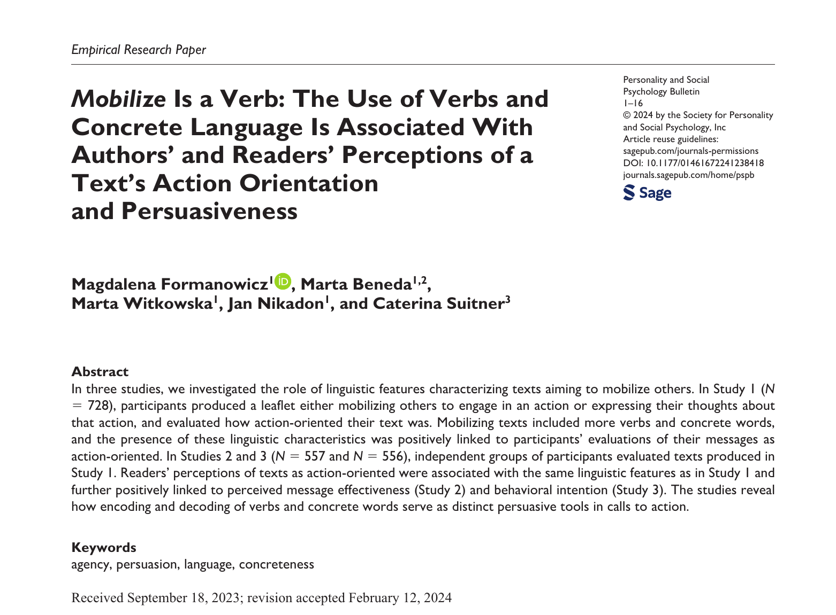
Studies
Studies 1, 2 and 3
Behavioral experiments
Published (PSPB).
Study 4:
Social media data
Under review
Bonus Study:
Behavioral experiments

Slide 11
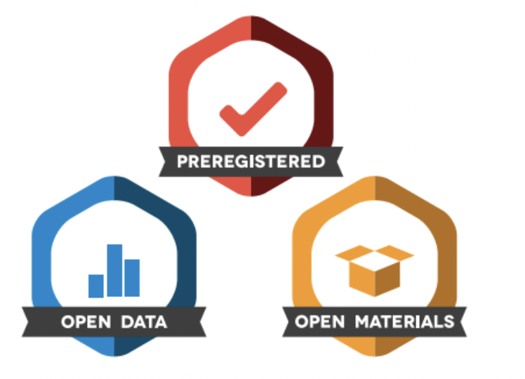
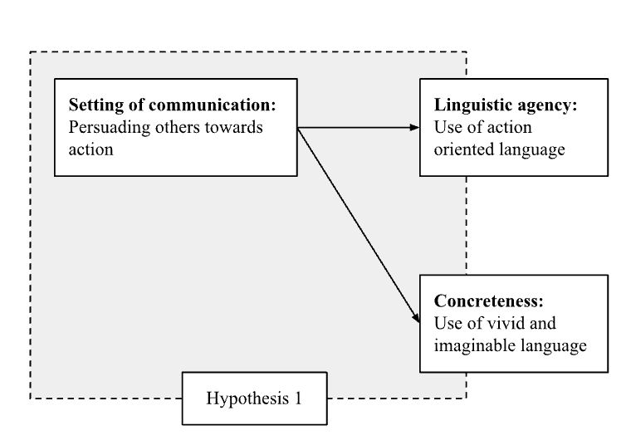
Hypothesis 1
Both encoded and decoded in language
Both objectively quantifiable
Verbs → Linguistic agency (Action orientation)
Concreteness → Action planning
(imaginable and contextualized information necessary for action implementation)
Notes:
A message successfully directing a message recipient towards a goal, might seek to evoke an intention to act and provide instructions on how to implement that intention.
We relate the action-intention component to the use of verbs, a linguistic category prototypically related to
and action planning to concreteness representing imaginable or contextualized information necessary for implementation.
The two features can be decoded from language and prompt recipients to act along the speaker's intentions, thus contributing to the construction of the shared meaning between the involved partners.

Slide 12
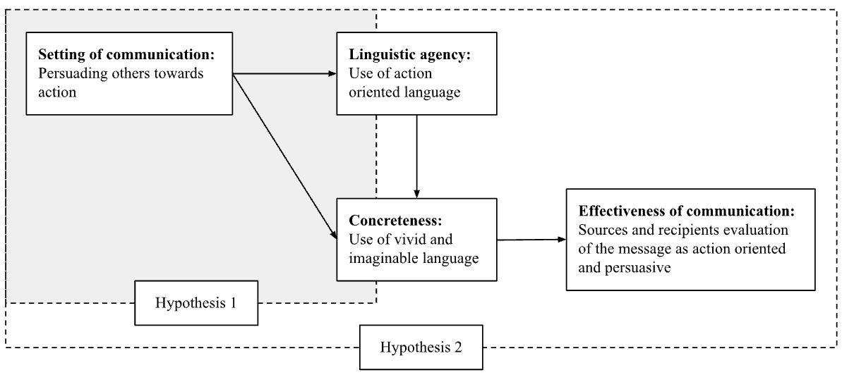
Hypothesis 2
Notes:
A + R should link these features to message persuasiveness

Slide 13
Study 1: Participants
445 English native speakers recruited through Prolific
312 women, 128 men, and five people who indicated other gender
Aged between 18 and 77 (M = 33.78, SD = 11.73)

Slide 14
Study 1: Procedure
Write a short text on the topic related to environmental action (context A) or volunteering (context B)
At least 100 words long
Either
Encouraging others to participate in the behaviour (‘encouraging others’ condition);
Expressing their thoughts on participating in the behaviour (‘expressing thoughts’ condition);
Participants (authors) asked to evaluate the text they had written in terms of action orientation:
how much the message conveyed by text you wrote could be considered: “practical”, “task-oriented”, and “focused on getting things done” (Cronbach’s α = .81).

Slide 15
Study 1: Measures
Verbs (← Grammatical Agency, Action Orientation):
the percentage of lexical verbs in their base form (VB; e.g., ‘work’, ‘love’) relative to the total number of words in the text; (SpaCy, Explosion Ai, Honnibal and Montani, 2017);
Linguistic Concreteness (Action Planning):
concreteness ratings provided for over 40,000 English words by over 4,000 participants (Brysbaert et al., 2014);
Author’s Ratings of Action Orientation:
Participants were asked to indicate on a 7-point scale the extent to which the text written by them could be considered: “practical”, “task-oriented”, and “focused on getting things done”.

Slide 16
Study 1: Examples
Express thoughts:
Environmental action has never had so much traction and focus as it has nowadays. Up to this point in human history, it has been about advancement and marvelling at out intelligence and what we can do. In the last couple of decades, awareness has grown around the impact we are having on the planet. There is much enlightenment and positive action to reduce the impact we are having on the planet in an effort to be more sustainable. Yes there are certainly many doubts over "green label" initiatives and the benefits that they purport to yield - zero carbon badges can sometimes hide scenarios where they are actually worse than conventional "non green" actions. So environmental action is a great thing in general, and I do and will participate, but am also mindful of the bigger picture and what I'm trying to achieve. blocking a road for the purpose of "Insulate Britan" is actually harmful to the cause and I believe actually is a hindrance to taking positive steps.
Encourage:
Please take care of our environment. This is really important as we only have one planet and our actions are causing it harm. We can do this is many different ways things like walking or using a bike where possible instead of motorised fossil fuel transport. Turning the heating or air conditioner down and instead dressing suitably for the weather. Drying clothes outside instead of using a tumble dryer and only washing clothes when actually dirty. Skipping fast fashion makes a huge difference as fast fashion is a major polluter. Wear clothes for as long as possible repair when needed. Avoiding buying new clothes due to them being trendy. You can also buy clothes from thrift shops, ebay, vinted etc instead of buying new.

Slide 17
Study 1: Examples
Express thoughts:
Environmental action has never had so much traction and focus as it has nowadays. Up to this point in human history, it has been about advancement and marvelling at out intelligence and what we can do. In the last couple of decades, awareness has grown around the impact we are having on the planet. There is much enlightenment and positive action to reduce the impact we are having on the planet in an effort to be more sustainable. Yes there are certainly many doubts over "green label" initiatives and the benefits that they purport to yield - zero carbon badges can sometimes hide scenarios where they are actually worse than conventional "non green" actions. So environmental action is a great thing in general, and I do and will participate, but am also mindful of the bigger picture and what I'm trying to achieve. blocking a road for the purpose of "Insulate Britan" is actually harmful to the cause and I believe actually is a hindrance to taking positive steps.
Encourage:
Please take care of our environment. This is really important as we only have one planet and our actions are causing it harm. We can do this is many different ways things like walking or using a bike where possible instead of motorised fossil fuel transport. Turning the heating or air conditioner down and instead dressing suitably for the weather. Drying clothes outside instead of using a tumble dryer and only washing clothes when actually dirty. Skipping fast fashion makes a huge difference as fast fashion is a major polluter. Wear clothes for as long as possible repair when needed. Avoiding buying new clothes due to them being trendy. You can also buy clothes from thrift shops, ebay, vinted etc instead of buying new.

Slide 18
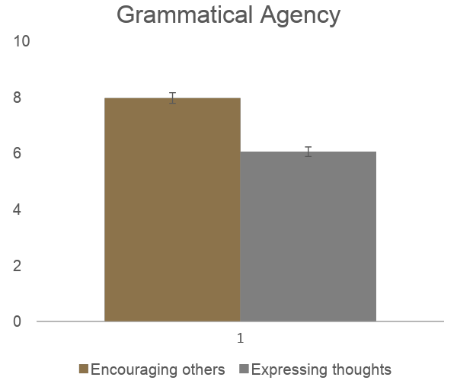
Study 1: Results: Grammatical Agency (Verbs)
We conducted a series of two-way ANOVAs in the following design: 2 (experimental condition: ‘encouraging others’ vs. ‘expressing thoughts’) x 2 (study context: environmental action vs. volunteering)
Grammatical Agency (Verbs)
Main effect of experimental condition
F(1, 441) = 54.75, p < .001, 𝜂² = .11

Slide 19
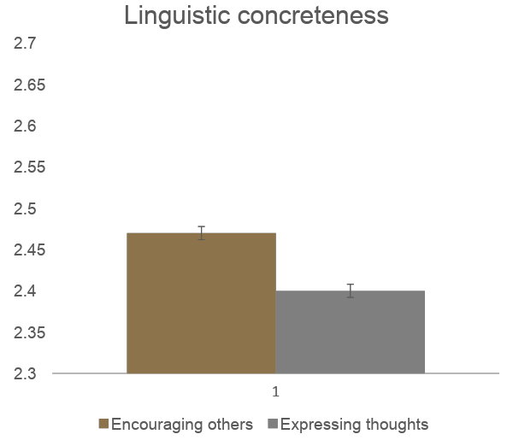
Study 1: Results: Linguistic Concreteness
We conducted a series of two-way ANOVAs in the following design: 2 (experimental condition: ‘encouraging others’ vs. ‘expressing thoughts’) x 2 (study context: environmental action vs. volunteering)
Linguistic Concreteness:
Main effect of experimental condition:
F(1, 441) = 48.70, p < .001, 𝜂² = .10.

Slide 20
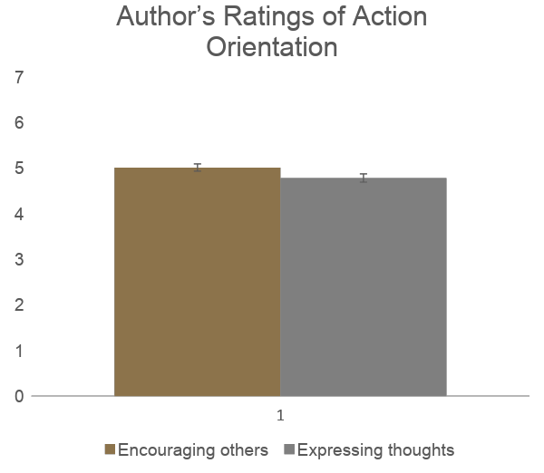
Study 1: Results: Action Orientation (Author)
We conducted a series of two-way ANOVAs in the following design: 2 (experimental condition: ‘encouraging others’ vs. ‘expressing thoughts’) x 2 (study context: environmental action vs. volunteering)
Author’s Ratings of Action Orientation:
Main effect of experimental condition:
F(1, 441) = 4.38, p < .05, 𝜂² = .01.

Slide 21
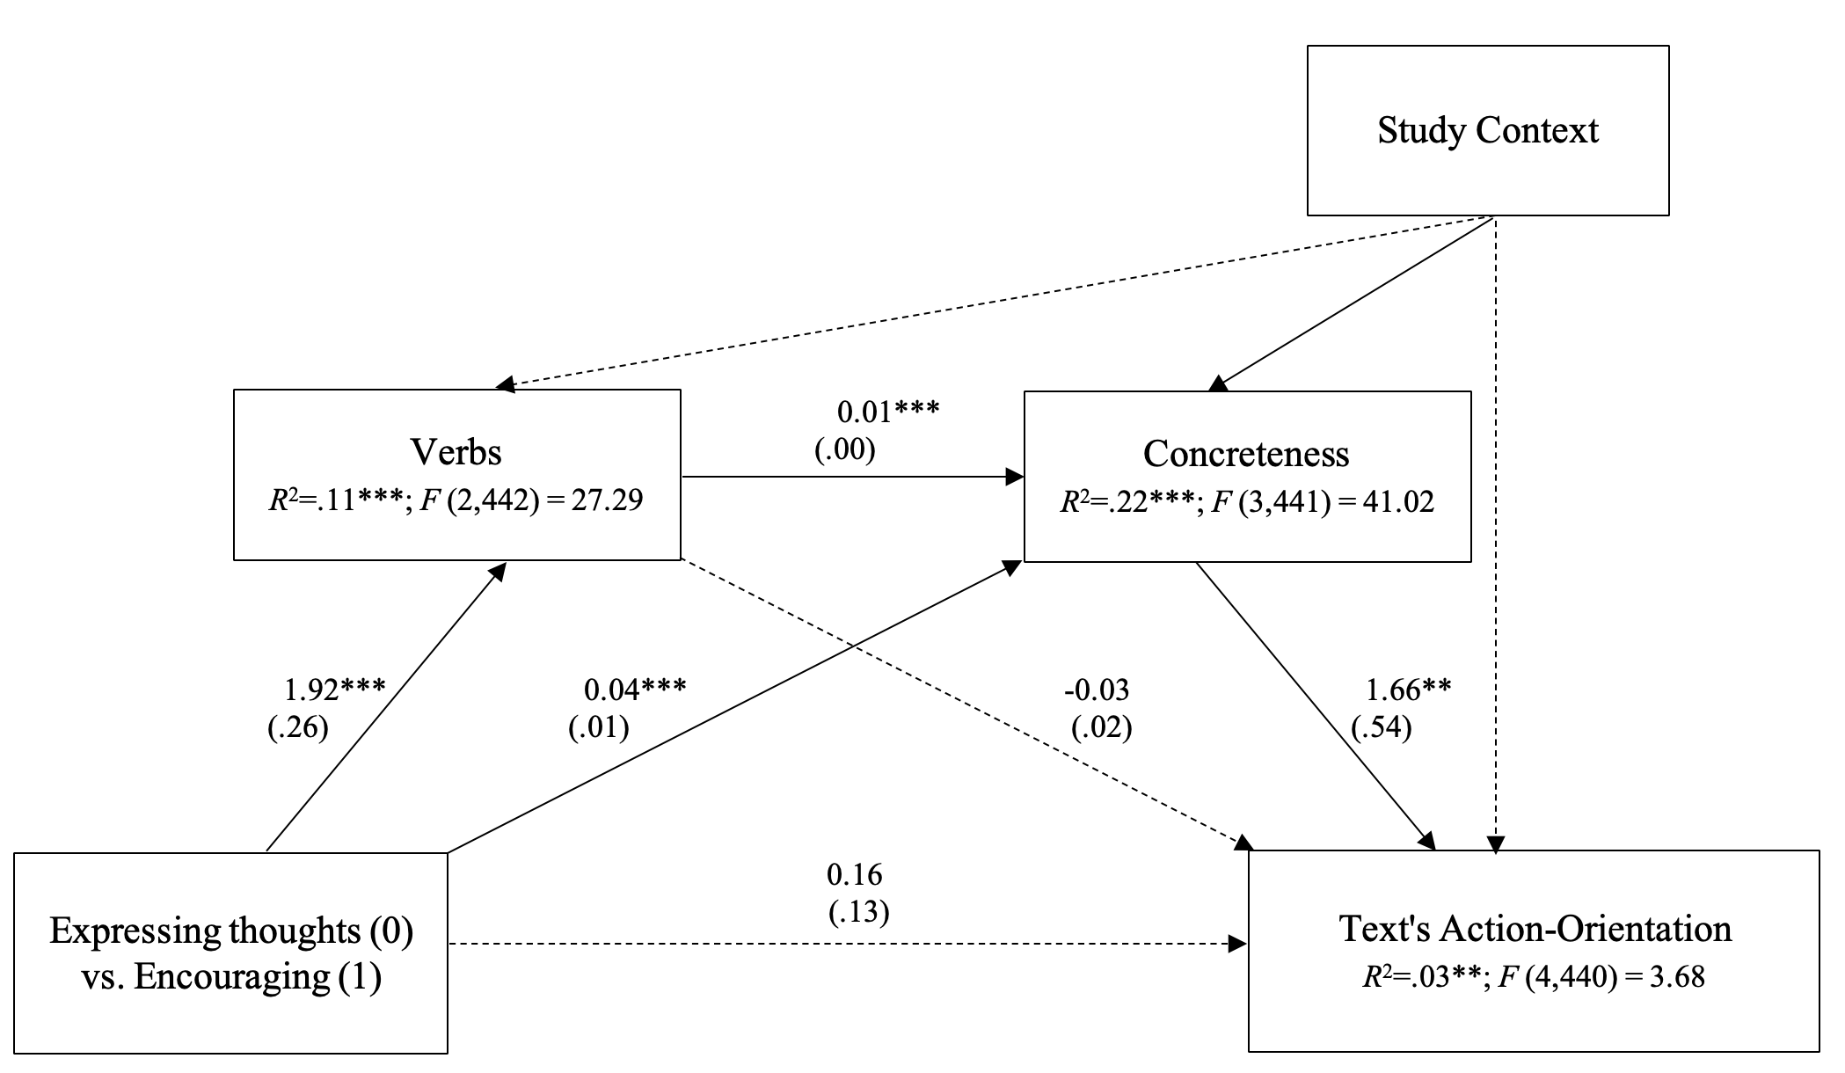
Study 1: Results: Mediation Analysis

Slide 22
Studies 2 and 3 [Readers]: Procedure
Participants were randomly presented with one of the leaflets produced in Study 1, asked to read it carefully and to evaluate it in terms of agency and persuasiveness
47 leaflets were excluded because they were too long; two leaflets were excluded because they were not written on the topic
We further excluded “badly written leaflets” (57 from Study 2 & 61 from Study 3);
English native speakers recruited through Prolific (Study 2: N = 339, Study 3: N = 335).

Slide 23
Studies 2 and 3 [Readers]: Measures
Reader’s Ratings of Action Orientation (Study 2 & 3):
Participants were asked to indicate on a 7-point scale the extent to which the text presented to them could be considered: “practical”, “task-oriented”, and “focused on getting things done”
Reader’s Ratings of Persuasiveness (Study 2):
Participants were asked to indicate on a 7-point scale how much the text encourages them to participate in the behaviour specified (i.e., environmental action/volunteering) and how much it would encourage others to participate in said behaviour
Reader’s Ratings of Behavioral Intention (Study 3):
Participants were asked to indicate on a 7-point scale how much the text encouraged their environmental action or volunteering.

Slide 24
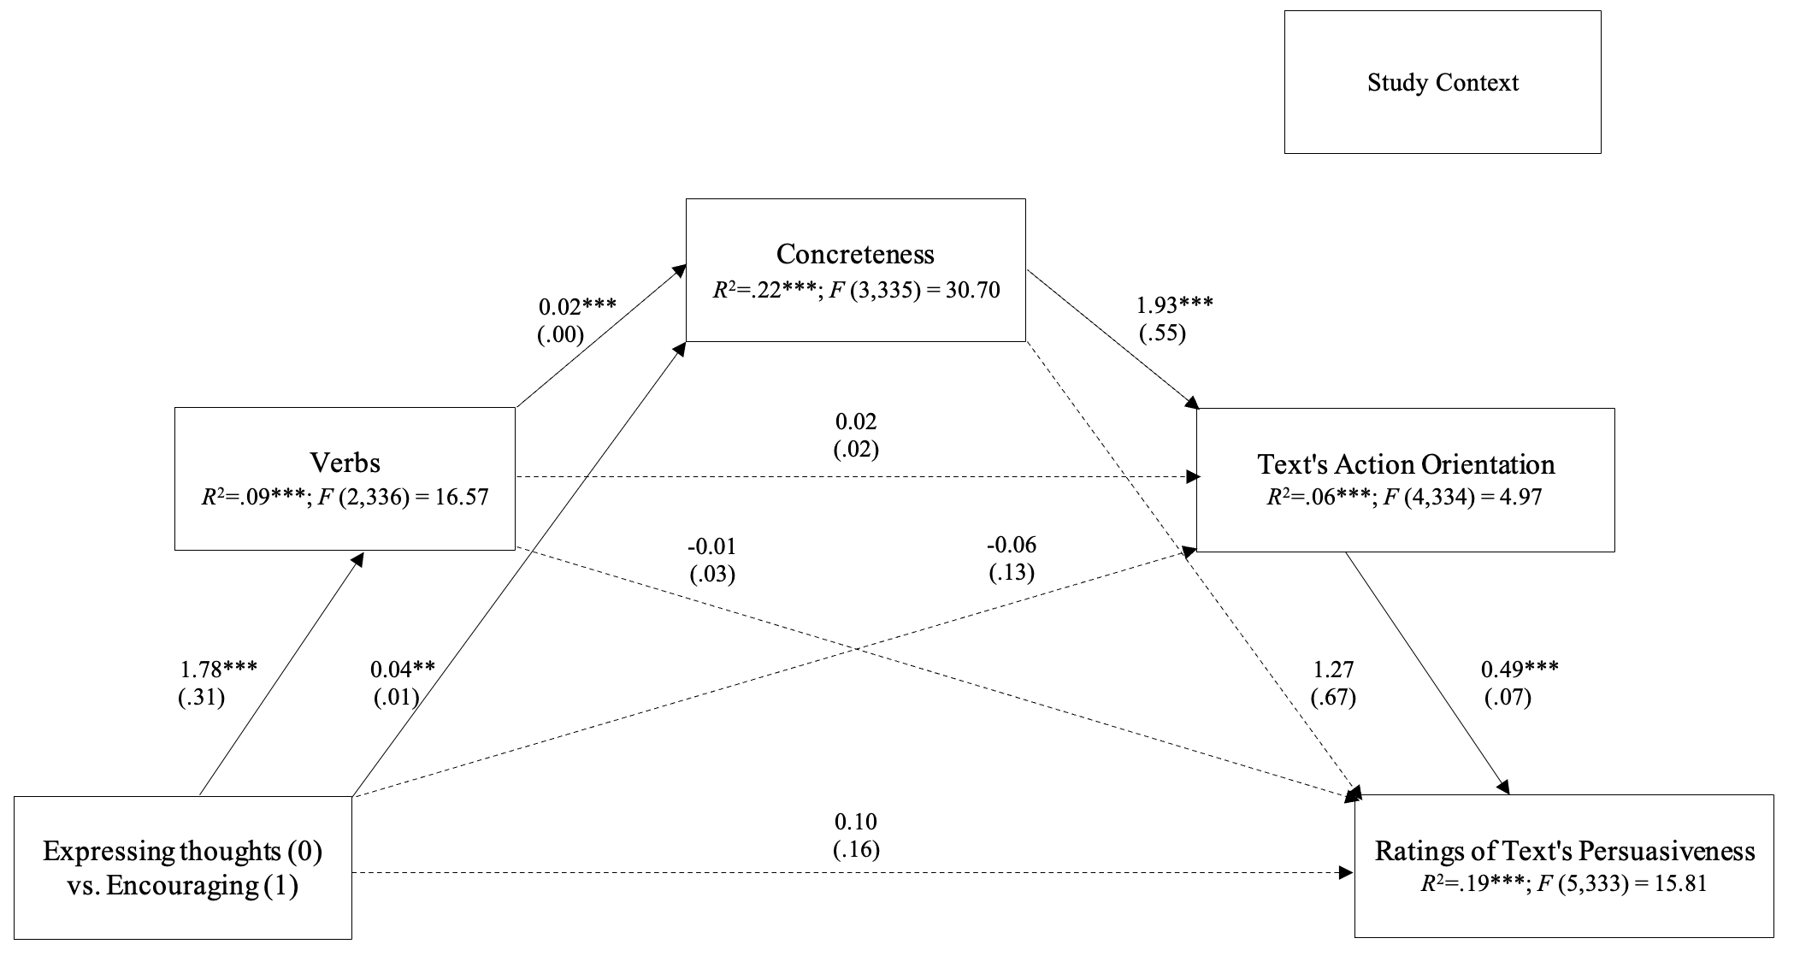
Study 2: Results: Mediation Analysis

Slide 25
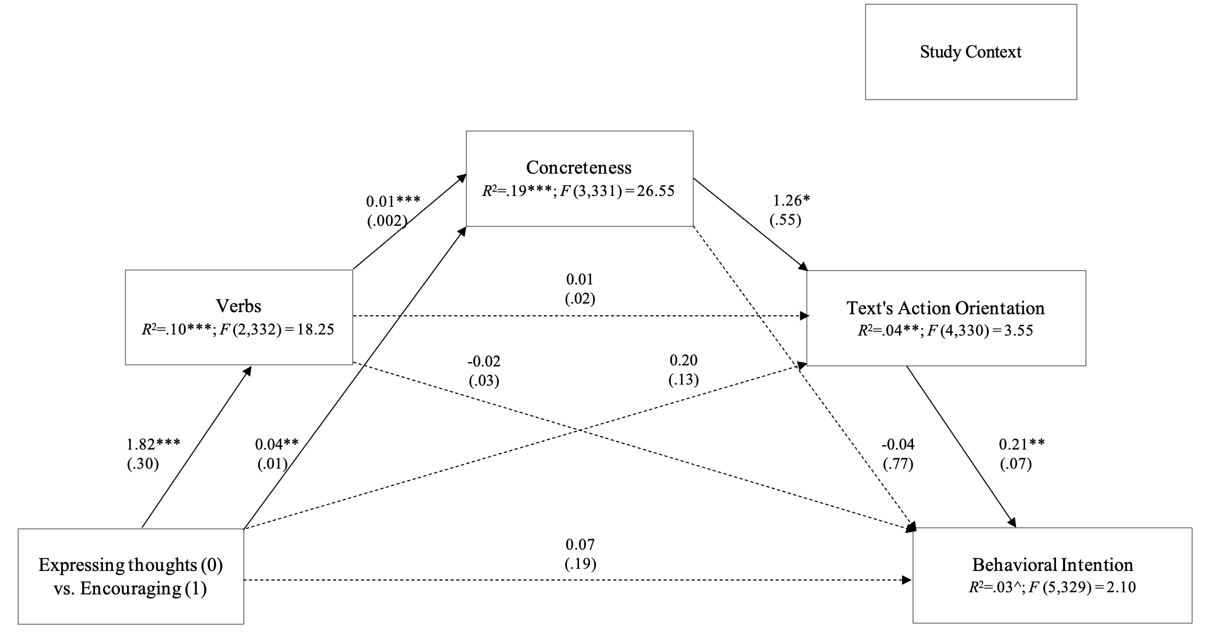
Study 3: Results: Mediation Analysis
Notes:
"How likely are you to do the following": - "Volunteer your time or money in the next four weeks" - "Engage in voluntary work more than in the past four weeks" - "Support a charitable organisation or event in the next four weeks"

Slide 26
Study 4: 2020 U.S. Congressional Election Tweets
Real-life (election) Context
Politicians may align their language with their persuasive goals;
Use of agentic language:
Function as a catalyst for action orientation among constituents, effectively serving as a tool for mobilization
Also, enhances perceptions of the speaker's agency, thereby boosting the perceived effectiveness of the campaign (Formanowicz et al., 2021)
Longitudinal approach:
We examined whether as actors come closer to their goal they will also use more agentic language.
Notes:
We tested whether agentic communication occurs in real life context. We took a

Slide 27
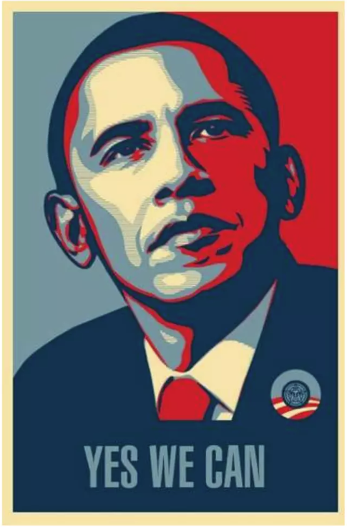

Slide 28


Slide 29
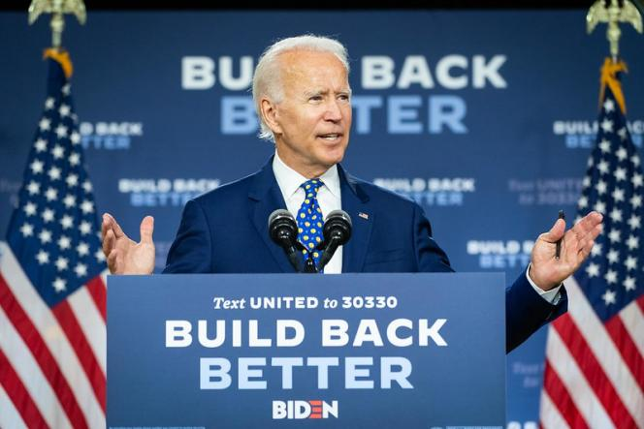

Slide 30


Slide 31


Slide 32
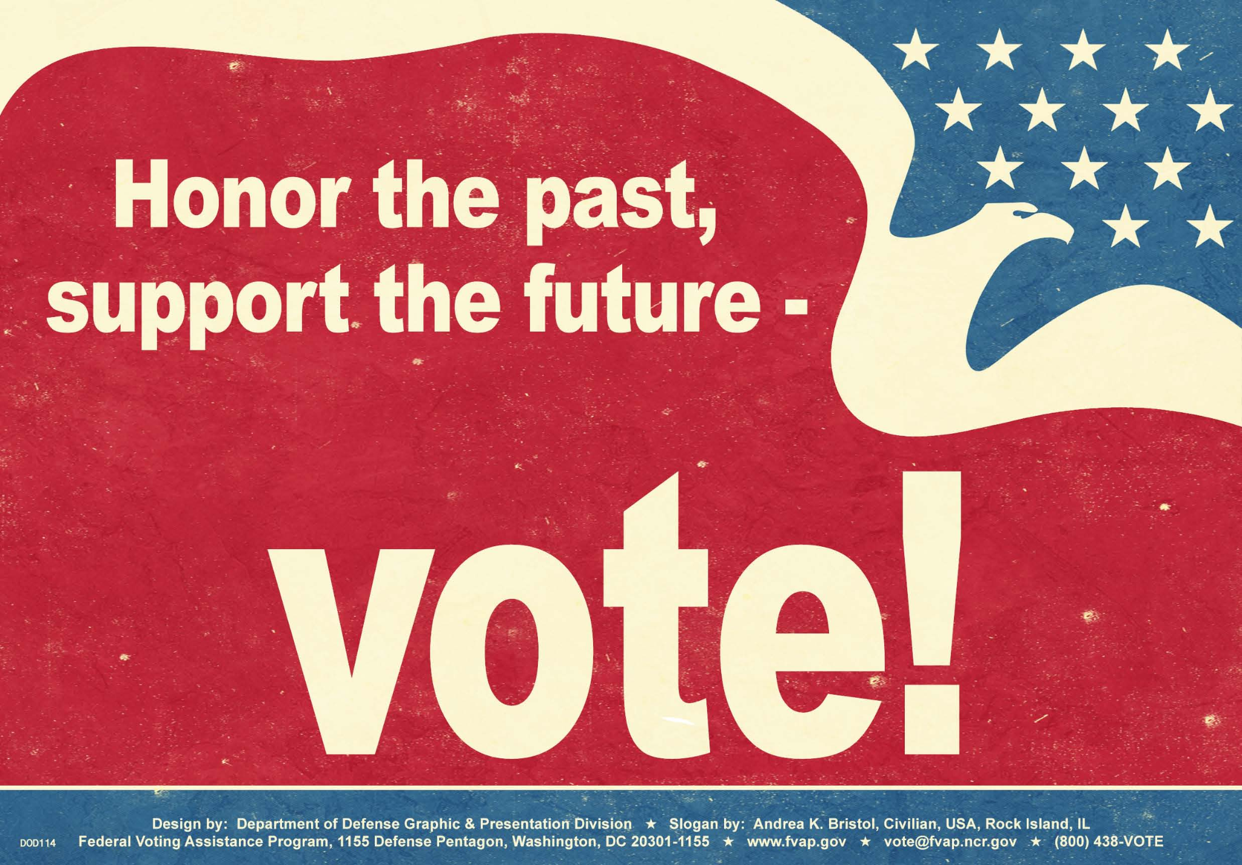

Slide 33
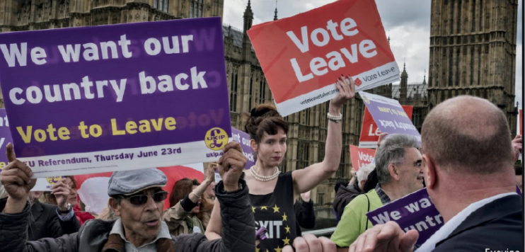

Slide 34
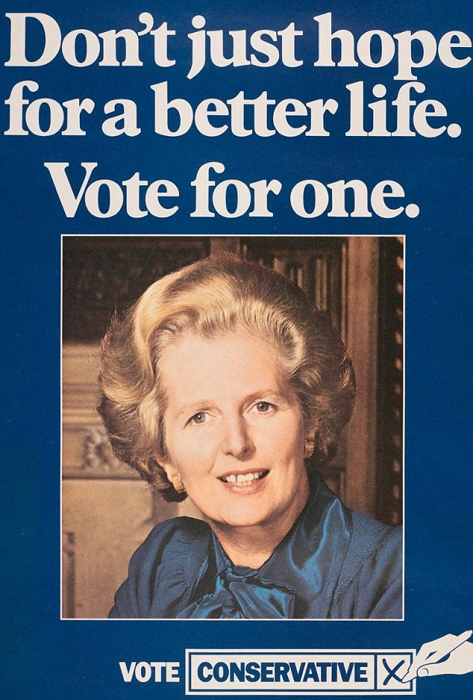
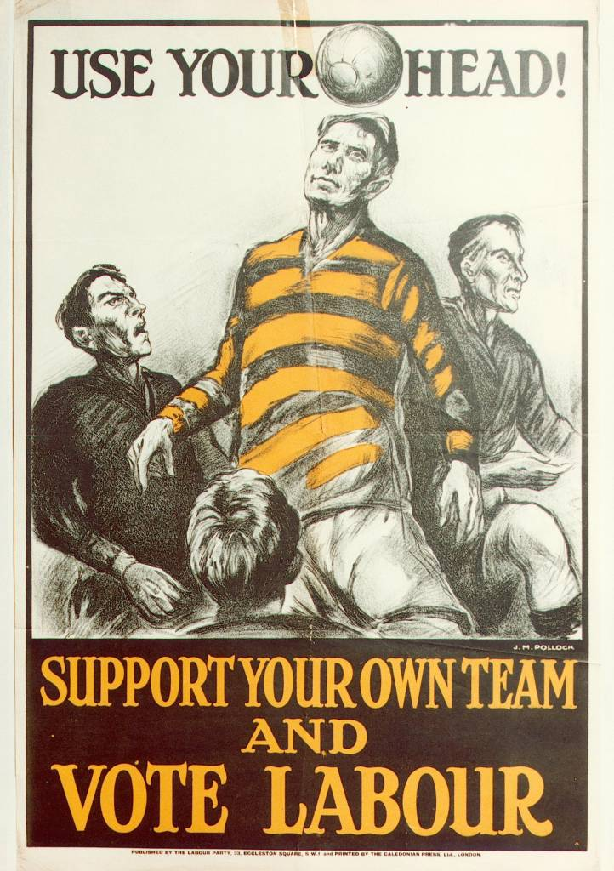

Slide 35
Agency is also prevalent in commercial setting…

Slide 36


Slide 37


Slide 38


Slide 39
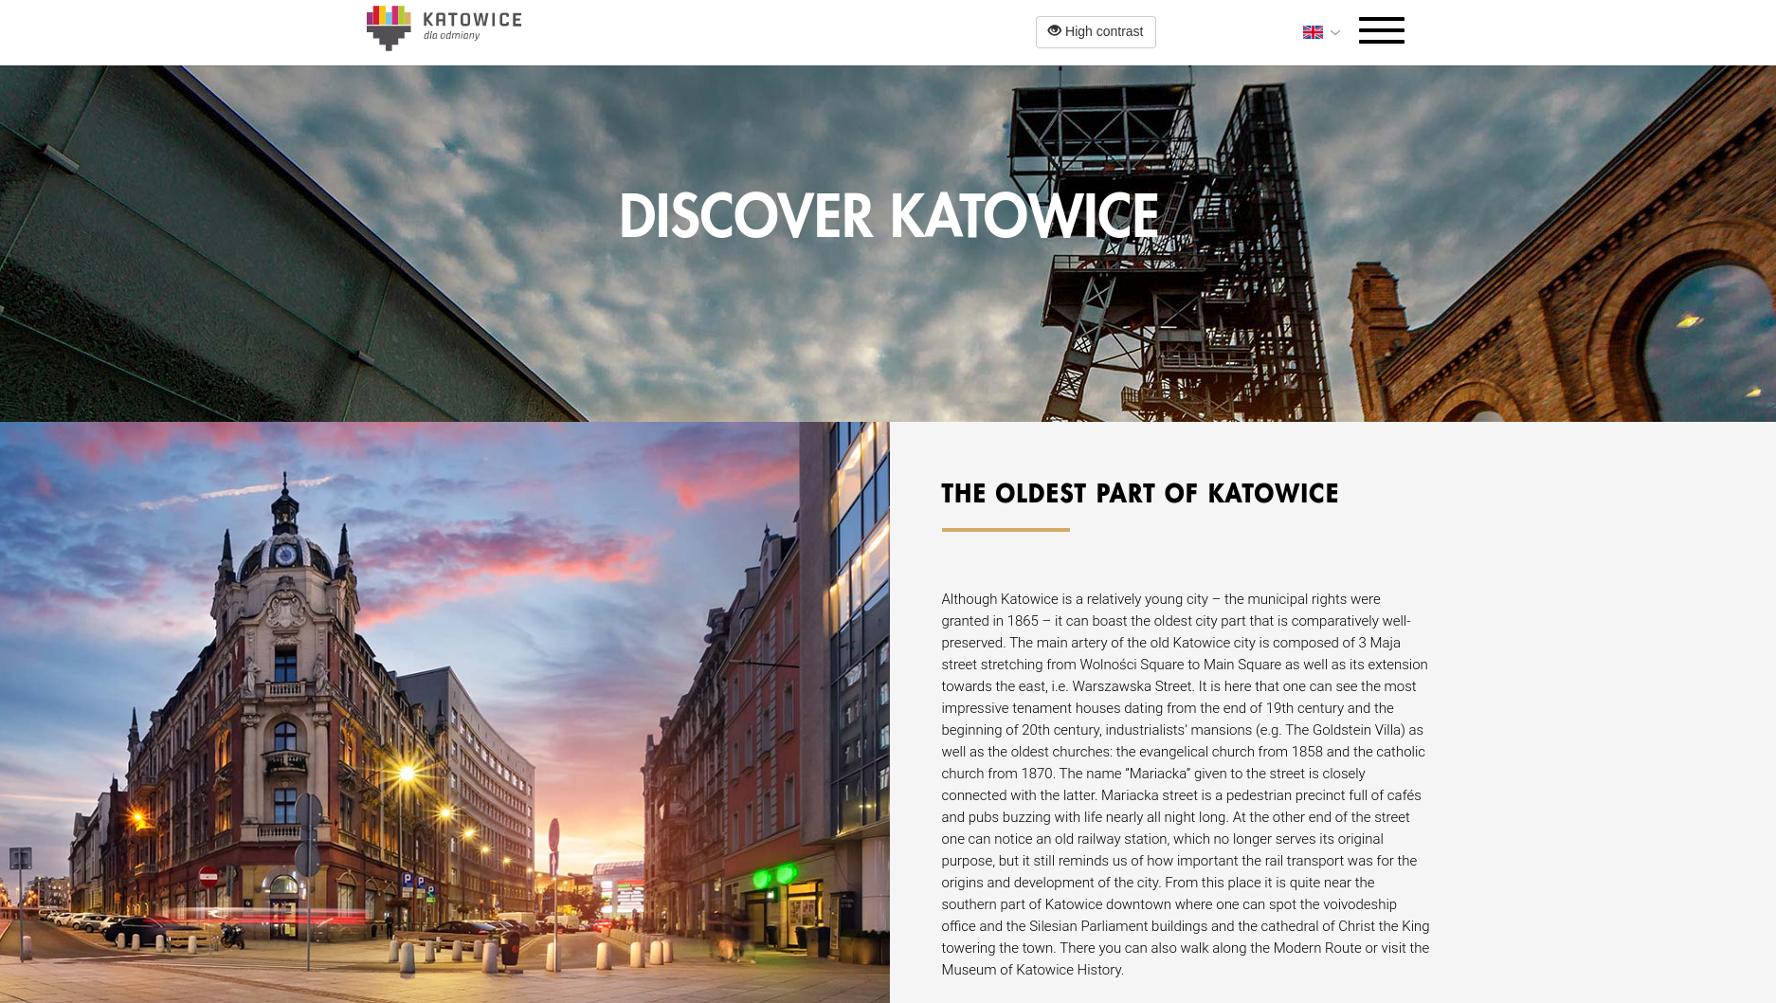

Slide 40
Study 4: 2020 U.S. Congressional Election Tweets
Based on the notion that politicians may align their language with their persuasive goals we hypothesized that:
The frequency of agentic language use escalated as the election approached (H1) and
… declined afterward (H2),
Agentic communication will increase in before the January 6th Capitol riots (H3)
following Donald J. Trump’s tweet announcing the January 6th rally, presumably with an intention to influence the Electoral College vote count ("Statistically impossible to have lost the 2020 Election. Big protest in D.C. on January 6th. Be there, will be wild!", Dec 19th).
Following the Capitol riots - a decrease in agentic language (H4)

Slide 41
Study 4: 2020 U.S. Congressional Election Tweets
~ 0.5M original tweets from Democrat (D) and Republican (R) candidates;
180 days prior and after the election;
870 candidates (454 D and 416 R)
1283 Twitter profiles (671 D and 612 R)
Agency was quantified in each tweet using BERTAgent;
A daily average was computed for every candidate.
Notes:
Why agency is relevant for elections (mobilization)

Slide 42
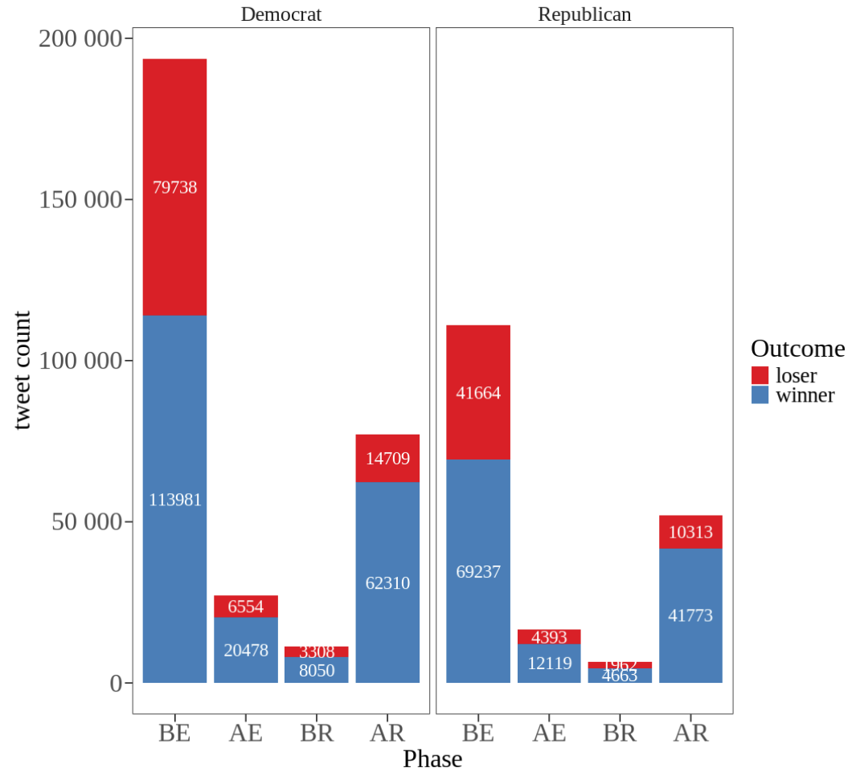

Slide 43
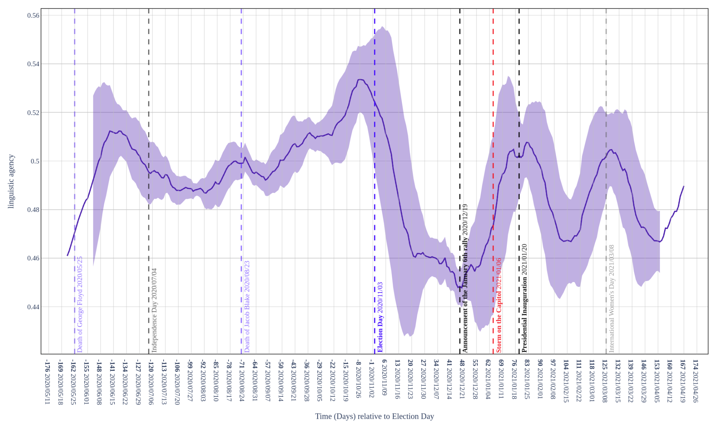
Notes:
KEEP ONLY ELECTION AND JAN 6th (VERTICAL LINES)
HIDE RIGHT HAND SIDE

Slide 44
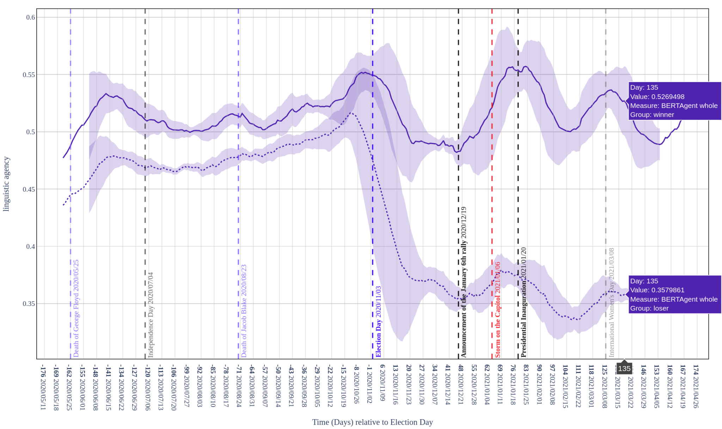

Slide 45
Study 4: Modelling of agency dynamics during election cycle
Agency ~ Time * Period + (Time | Name)

Slide 46
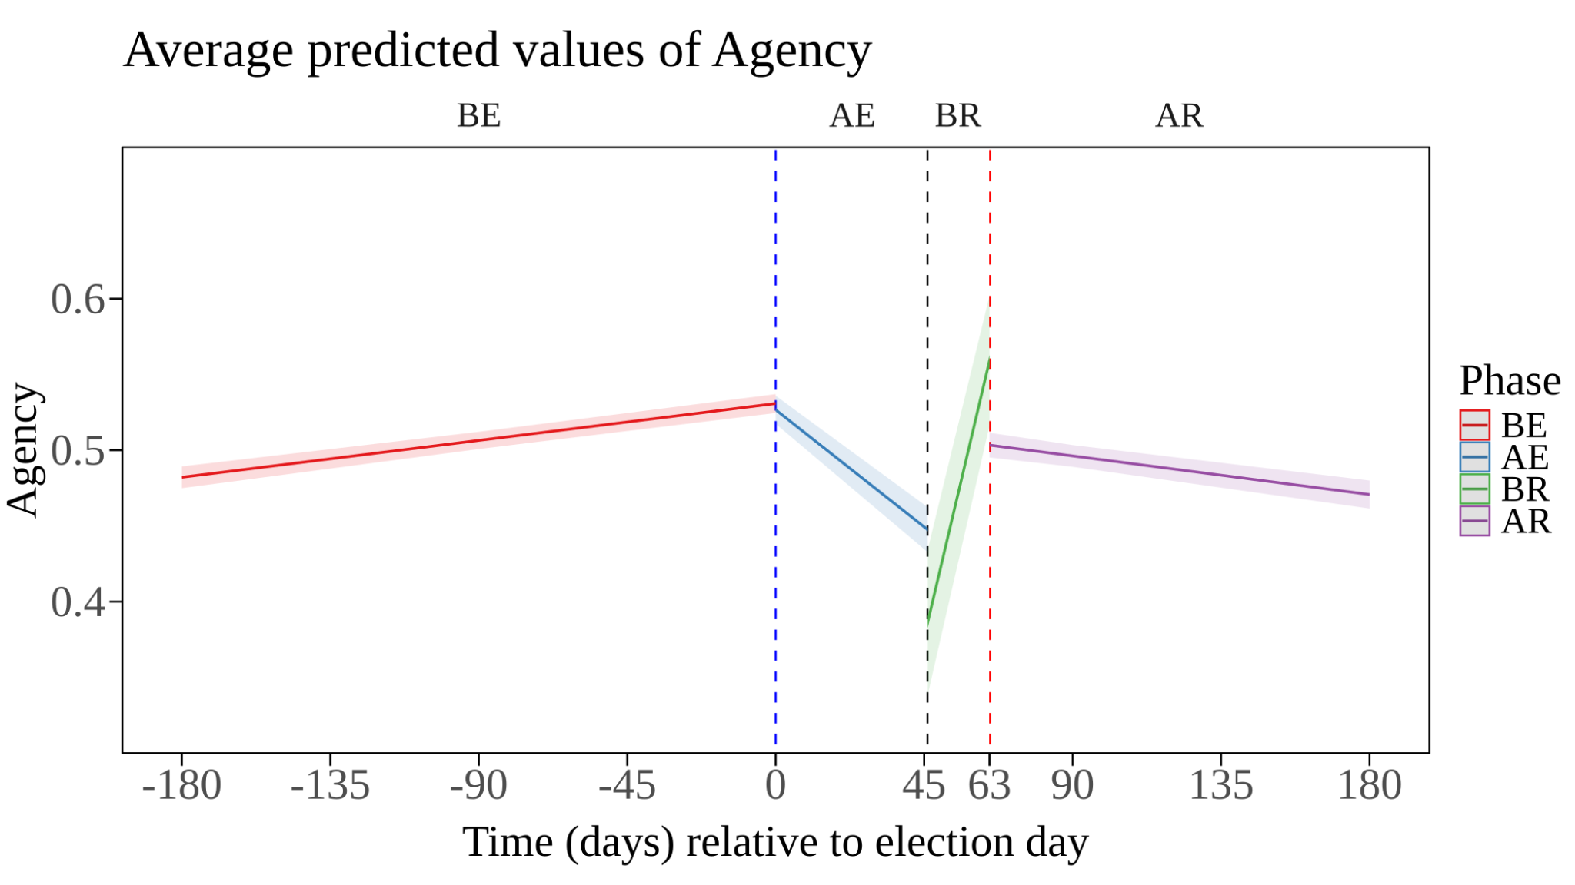

Slide 47
Study 4: Modelling of agency dynamics during election cycle
Agency ~ Time * Period * Outcome + (Time | Name)

Slide 48
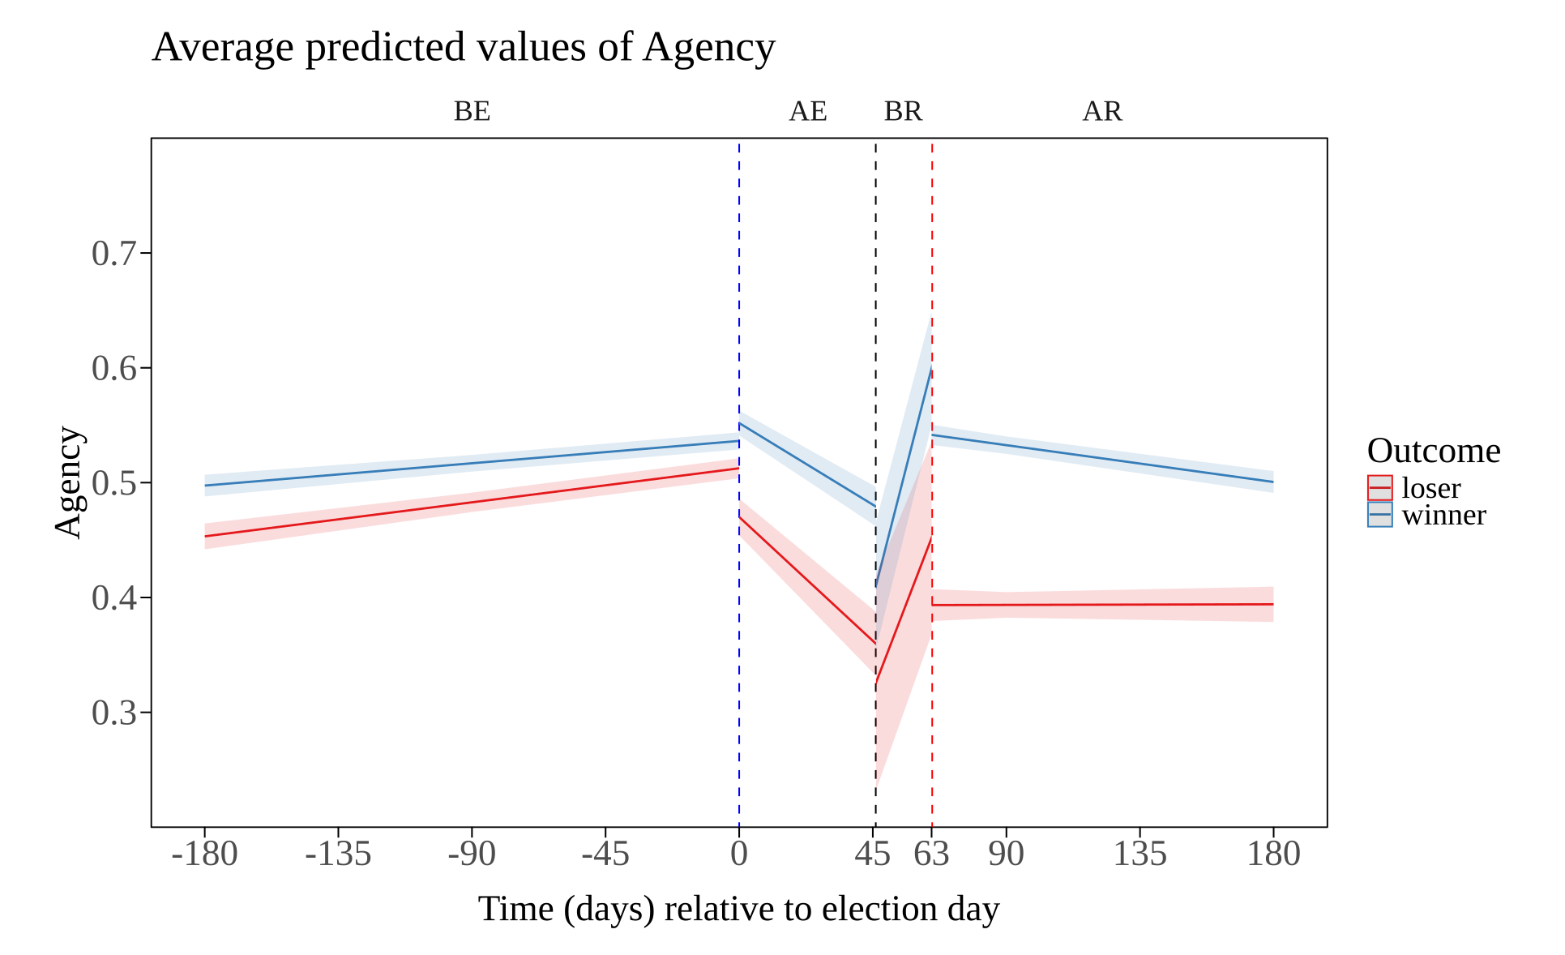

Slide 49
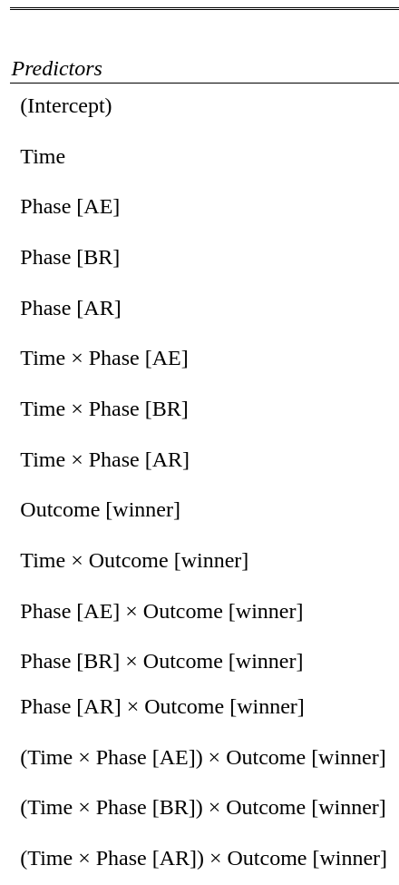
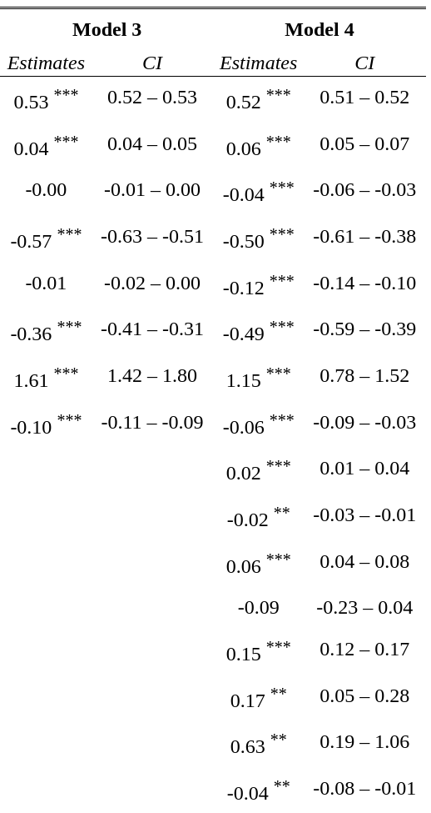

Slide 50
Concussions¹
People whose communicative goal is to persuade others employ linguistic devices that are associated with action orientation 🡪 agentic and concrete language
These devices are associated with recipients evaluations of the message: both in terms of perceived agency and persuasive appeal
Political communicators also employ these linguistic devices in line with the unfolding of their persuasive goals.
Politician’s linguistic agency‬ ‭increase‬s ‭while‬ ‭getting‬ ‭closer‬ ‭to‬ ‭a‬ ‭critical‬ ‭political‬ ‭event,‬ ‭be‬ ‭it‬ ‭a‬ ‭planned‬ ‭democratic ‬‭event ‬‭(Election‬‬ ‭Day),‬ ‭or‬ ‭a‬ ‭sudden‬ ‭disruptive‬ ‭protest‬ ‭(Capitol‬ ‭riots).
¹ 🤕

Slide 51
Bonus Study (Preliminary Results):
Topics
Raise awareness of mental health issues
Prevent climate change and protect environment
Increase voting turnout in elections
Reduce economic inequality
Increase volunteering
Advocate for free speech
Protect human rights
Ensure food security and sustainable agriculture
Advocate for digital privacy and security
Highlights by Authors (N = 800) and Readers (N = 800)

Slide 52
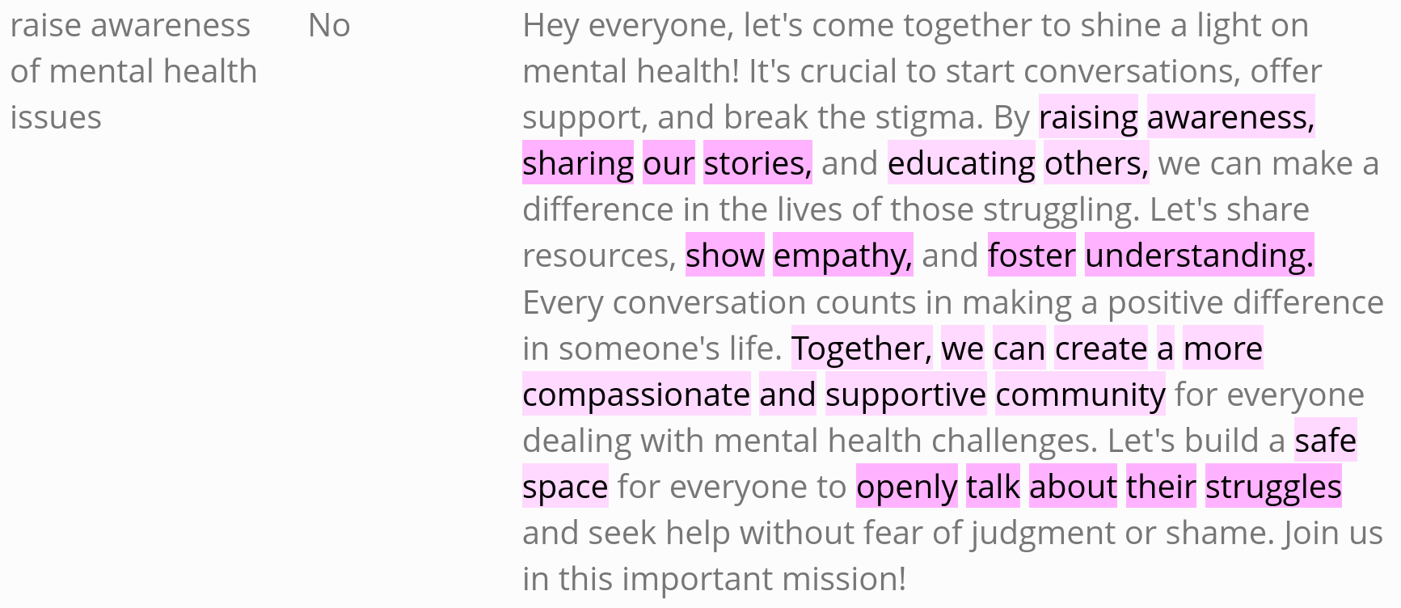
Notes:
discussion
This investigation is important because knowing what can increase social mobilization is particularly relevant nowadays, given the number of pressing issues that the world faces. The very same knowledge, however, can be used to inform a wider audience about how to become immune to that strategy when employed in a manipulative manner.
INNOCULATION
We intent to develop LLM to detect communication aimed and persuasion
N1=800
N2=800

Slide 53
Bonus Study (Preliminary Results):
Linguistic Feature ~ (1 | OrigRespId) + (1 | Topic) + Chunk * Type
Notes:
discussion
This investigation is important because knowing what can increase social mobilization is particularly relevant nowadays, given the number of pressing issues that the world faces. The very same knowledge, however, can be used to inform a wider audience about how to become immune to that strategy when employed in a manipulative manner.
INNOCULATION
We intent to develop LLM to detect communication aimed and persuasion
N1=800
N2=800

Slide 54
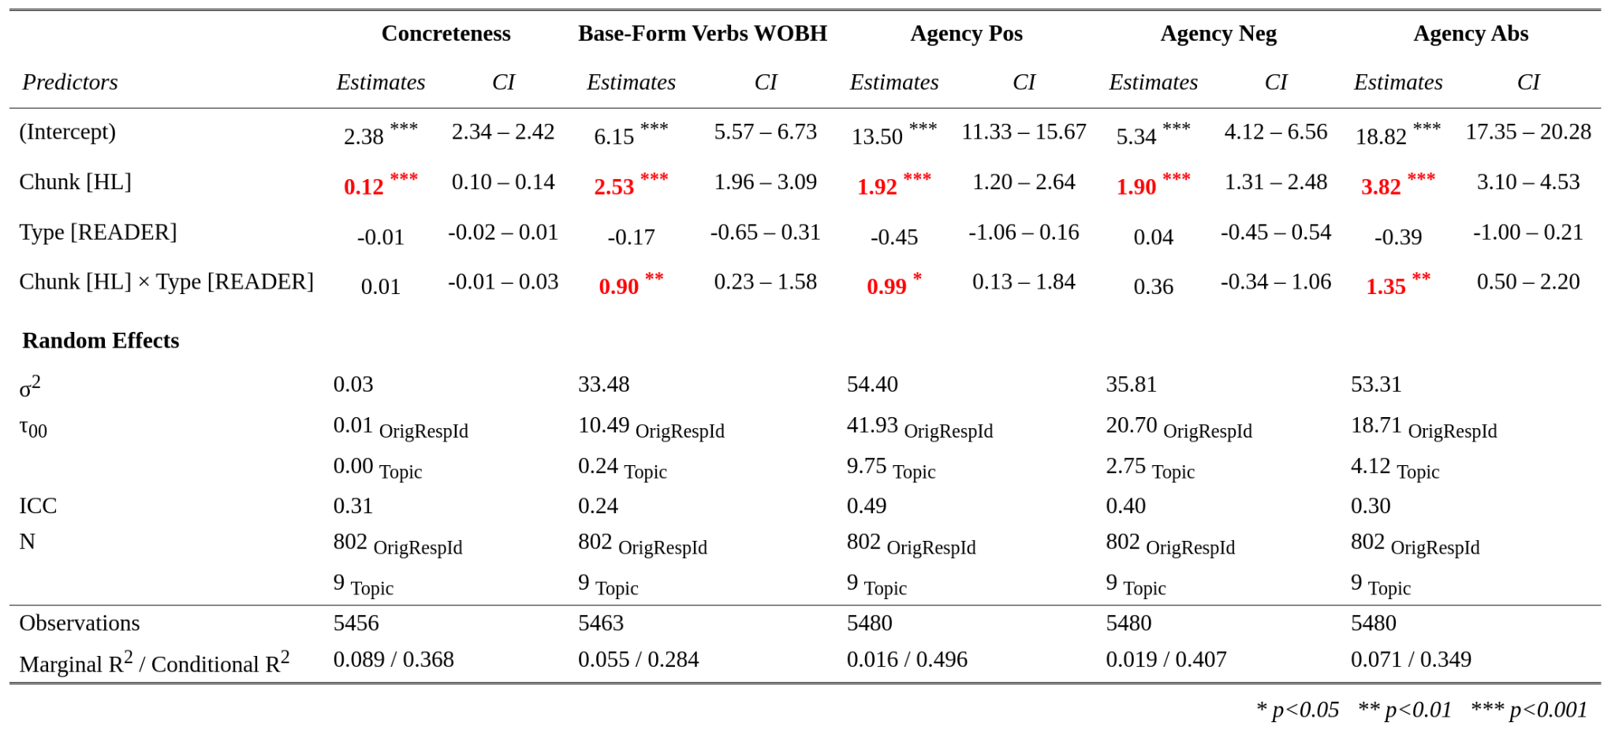
Linguistic Feature ~ (1 | OrigRespId) + (1 | Topic) + Chunk * Type
Notes:
discussion
This investigation is important because knowing what can increase social mobilization is particularly relevant nowadays, given the number of pressing issues that the world faces. The very same knowledge, however, can be used to inform a wider audience about how to become immune to that strategy when employed in a manipulative manner.
INNOCULATION
We intent to develop LLM to detect communication aimed and persuasion
N1=800
N2=800

Slide 55
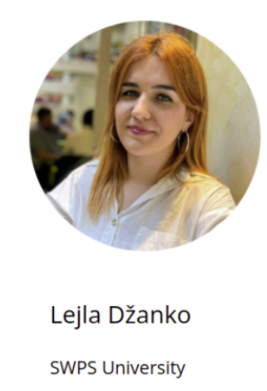
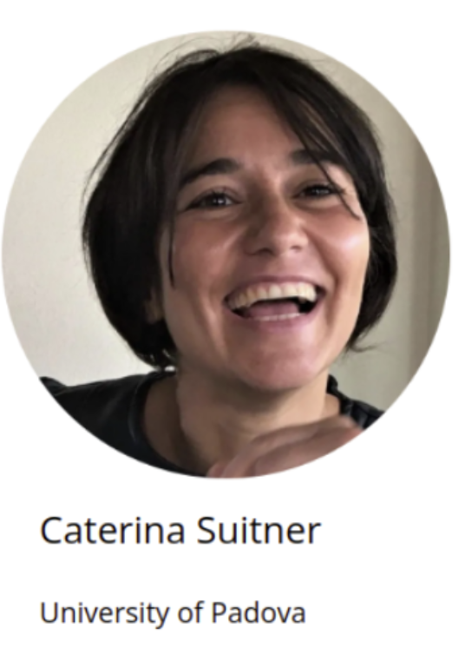
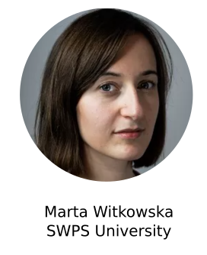

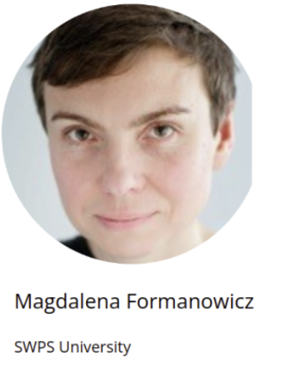


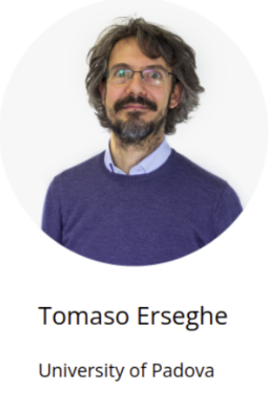

Thank you!

Slide 56
https://cogsys.io/polit/scatter_batch_0021_GAUSS_4.html
https://cogsys.io/polit/n0008-init.html

Slide 57
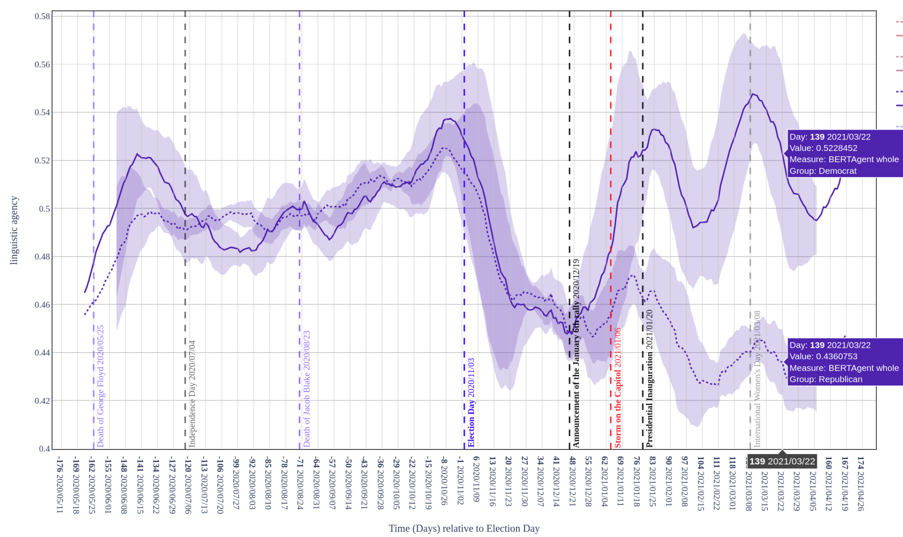

Slide 58
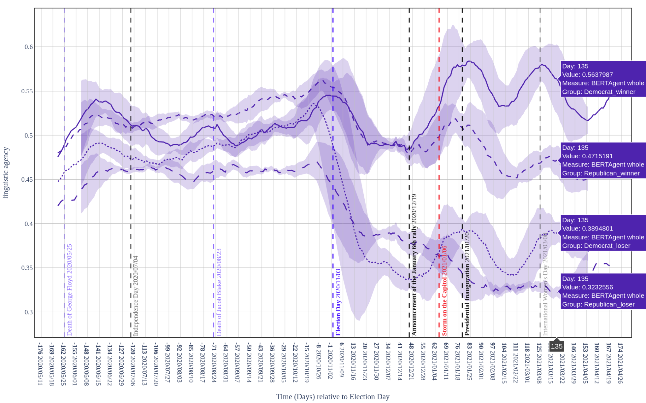

Slide 59
Agency
Notes:
KEEP ONLY ELECTION AND JAN 6th (VERTICAL LINES)
HIDE RIGHT HAND SIDE

Slide 60
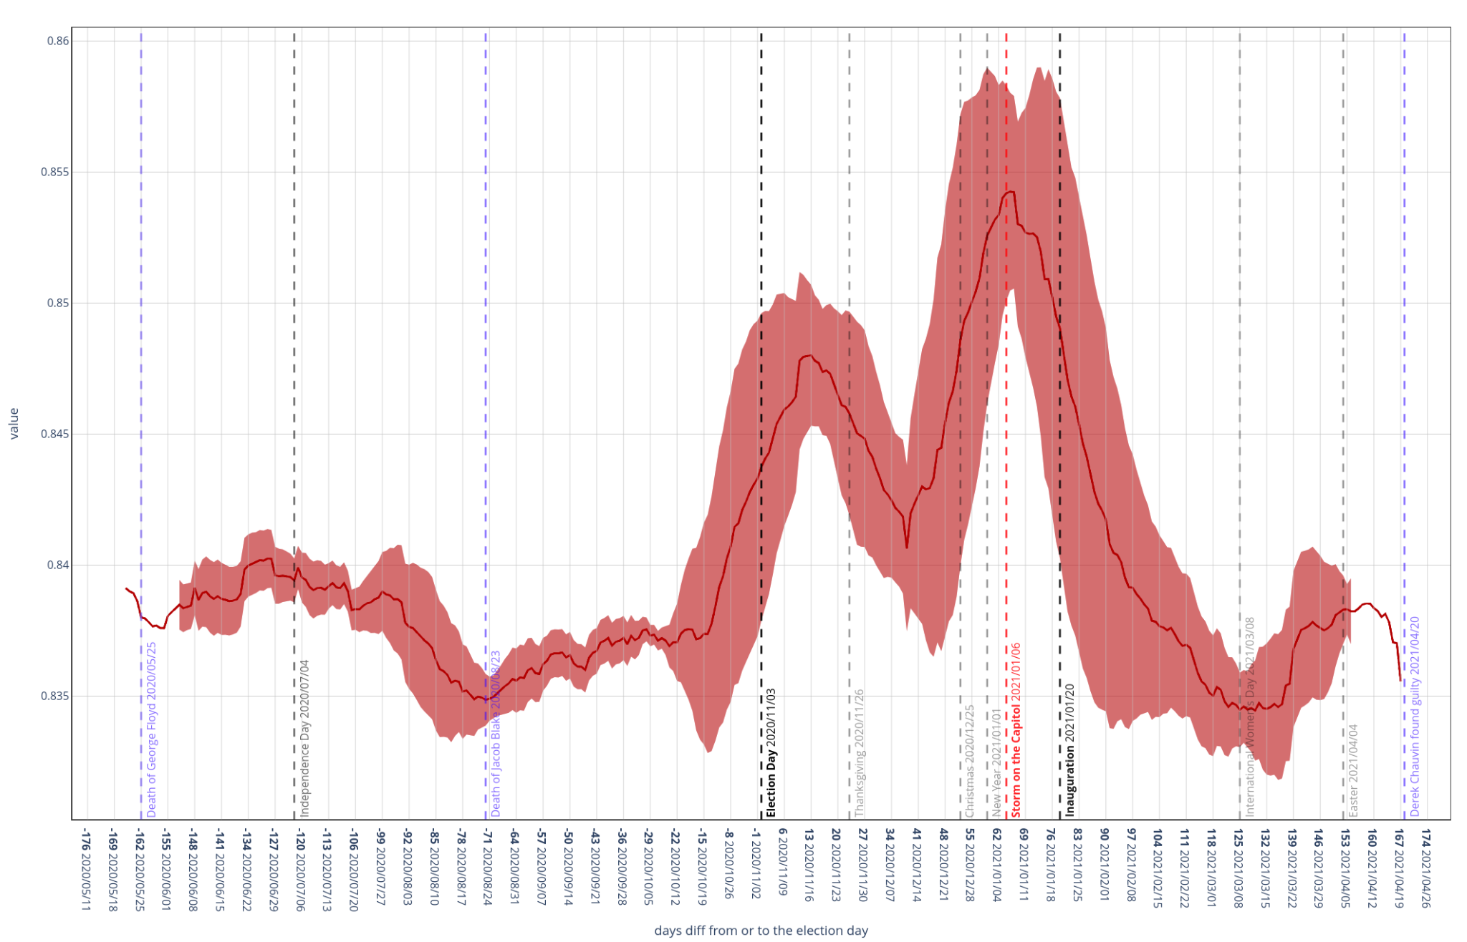
Concreteness
Notes:
Concreteness

Slide 61
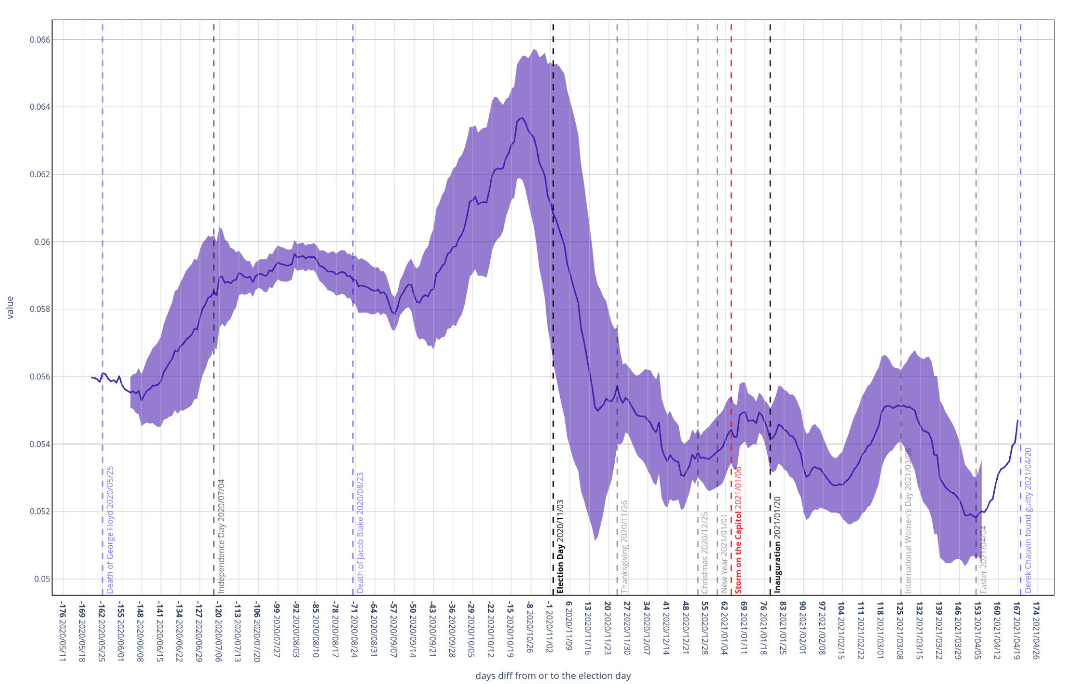
VB-WOBH
Notes:
Baseform Verbs WOBH

Slide 62
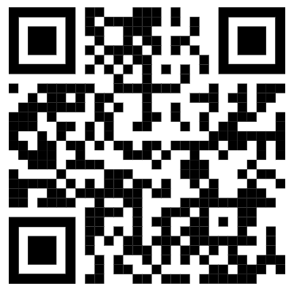
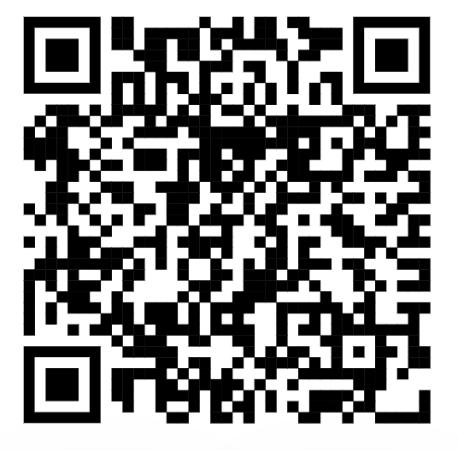
BERTAgent: Online resources
Preprint: https://psyarxiv.com/qw6u3/
SOM is available at https://github.com/cogsys-io/BERTAgent-SOM/
Installation from https://pypi.org/project/bertagent/
pip install bertagent
Documentation + tutorial: https://bertagent.readthedocs.io/
Source code: https://github.com/cogsys-io/bertagent/

Slide 63
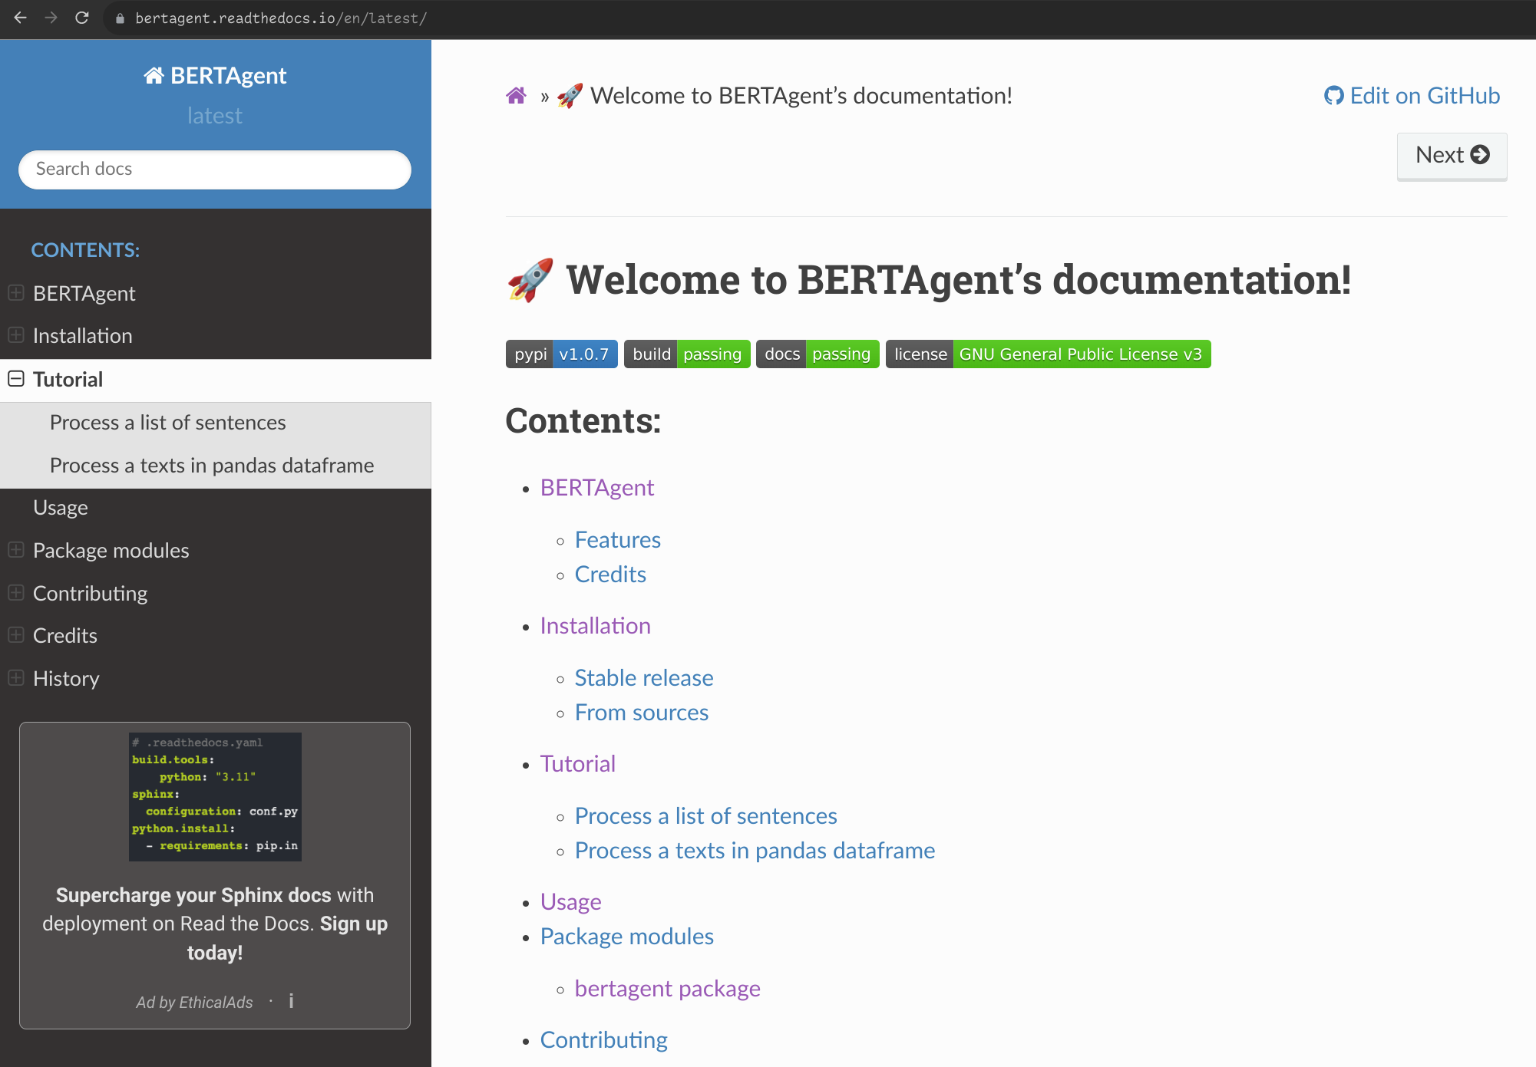

Slide 64
BERTAgent: A novel tool for quantifying linguistic agency:
An application in the analysis of mobilising election candidate support
on Twitter during the 2020 U.S. congressional elections
Jan Nikadon¹, Lejla Džanko¹, Tomaso Erseghe², Caterina Suitner³, Michal Olech⁴, Pawel Jurek⁵, Magadalena Formanowicz¹
¹ Center for Research on Social Relations, SWPS University, Warsaw, Poland
² Department of Information Engineering, University of Padova, Italy
³ Department of Psychology of Development and Socialization, University of Padova, Italy
⁴ Medical University of Gdańsk, Poland
⁵ Institute of Psychology at the University of Gdańsk, Poland
🖄 nikadon@gmail.com
#ICLASP18, Tallinn, 2024/06/15
This research was funded by the OPUS 19 grant of the Polish National Science Center awarded to Magdalena Formanowicz (2020/37/B/HS6/02587).

Slide 65
Agency
The ability to assign goals and pursue their achievement (Bakan, 1966; Bandura, 2001)
One of the most basal attributes of (all) biological systems (Arnellos & Moreno, 2015; Barandiaran & Moreno, 2008; Levin, 2019; Moreno, 2018)
An inherently agent-profitable trait (Frith & Frith, 2010)
For agents it provides a generalized functional value because...
it facilitates goal-achievement that translates into adaptive advantage (Moreno, 2018)
Notes:
MORE ON AGENCY <- introduce political language COLLECTIVE ACTION ALREADY HERE
SLOW DOWN HERE
STRIVE ACHIEVE DOMINATE
Yes WE CAN!

Slide 66
Agency
Enjoys attentional privilege (Abele & Wojciszke, 2007)
Identification of agency is:
one of the most important, privileged, and
deeply integrated (rapid and automatic) aspects of human cognition
(e.g., Hafri et al., 2013; Hafri et al., 2018; Rosander & von Hofsten, 2011)
Other agents capture our attention because...
their actions can affect (align or disrupt) the achievement of our own goals (Frith & Frith, 2010; New et al., 2007)
Notes:
MORE ON AGENCY <- introduce political language COLLECTIVE ACTION ALREADY HERE
SLOW DOWN HERE
STRIVE ACHIEVE DOMINATE
Yes WE CAN!

Slide 67
Agency
Pertains to:
goal-orientation and achievement;
a fundamental aspect of human cognition and behavior.
[for individuals, for interpersonal and group relations]
Critical for the analysis of human…
actions;
interactions;
social group dynamics;
Notes:
MORE ON AGENCY <- introduce political language COLLECTIVE ACTION ALREADY HERE
SLOW DOWN HERE
STRIVE ACHIEVE DOMINATE
Yes WE CAN!

Slide 68
Language
The most accessible and efficient tool for: reflecting, transmitting, and shaping/regulating socially relevant phenomena (Holtgraves & Kashima, 2008; Karasawa & Maass, 2008).
Speech acts are also inherently behavioral acts (Austin, 1962; Butler, 1997; Searle, 1969), and as such they convey (signal and express) agency.
Notes:
MORE ON AGENCY <- introduce political language COLLECTIVE ACTION ALREADY HERE
SLOW DOWN HERE
STRIVE ACHIEVE DOMINATE
Yes WE CAN!

Slide 69
Linguistic Agency
Agency is extensively encoded in language (de Hoop & Lamers, 2006; Formanowicz et al., 2017; Gardelle & Sorlin, 2018a, 2018b; Siewierska, 2004)
Linguistic agency (LA) also enjoys attentional privilege (Bornkessel-Schlesewsky & Schlesewsky, 2009; Muralikrishnan et al., 2015)
Notes:
MORE ON AGENCY <- introduce political language COLLECTIVE ACTION ALREADY HERE
SLOW DOWN HERE
STRIVE ACHIEVE DOMINATE
Yes WE CAN!

Slide 70
Tool Development Motivations
Researchers need a tool that is capable of…
detecting and quantifying linguistic agency in text (e.g. online textual exchanges):
with high precision,
at scale.
Potential applications include investigation of:
trajectories of social relations,
content of group stereotypes,
emergence and unfolding of collective action.

Slide 71
Existing Tools
Based predominantly on the dictionary word-count (DWC) methodology;
DWC was popularized by frameworks such as
General Inquirer (GI; Stone et al., 2007; Stone and Hunt, 1963)
Linguistic Inquiry and Word Count (LIWC; Pennebaker et al., 2015)
LIWC and GI contain dozens of — partly thematic and partly grammatical — word dictionaries (categories) that are used to detect, measure, and statistically compare a variety of psychologically relevant phenomena;
First problem: no agency-specific category in GI and LIWC.

Slide 72
Makeshift Solutions
Researchers either:
use combinations of existing dictionaries as a proxy for agency (e.g., Madera et al., 2009 used Cognitive Processes, Motion and Achievement from LIWC), or
prepare custom agency-specific dictionaries (e.g., Pietraszkiewicz et al., 2019)

Slide 73
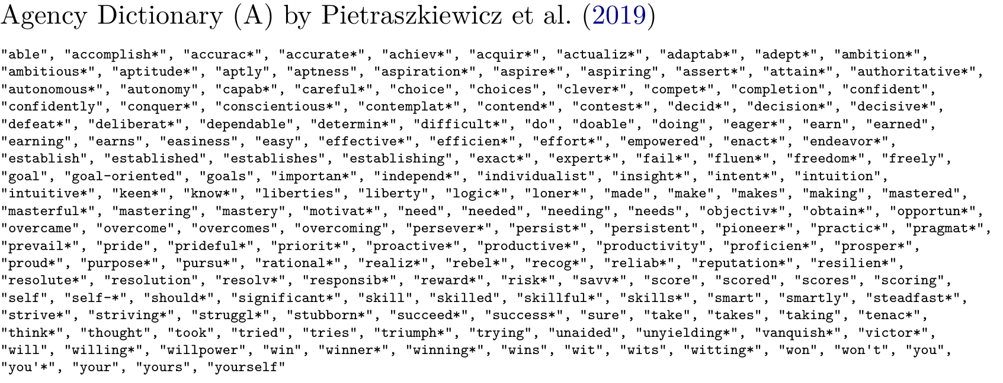
Example: Agency LIWC-style Dictionary

Slide 76
Existing tools: Pietraszkiewicz et al. 2019 and Nicolas et al. 2021
Dictionary word-count (DWC) methodology!
E.g., Linguistic Inquiry and Word Count (LIWC).
Pros:
methodological and applicational simplicity,
extensive validation in numerous studies.
Cons:
insensitivity to polysemy, e.g., we can lead them vs. this water contains lead;
insensitivity to negation, e.g., motivated vs. not motivated vs. not so much motivated;
insensitivity to gradation of agency conveyed by different concepts, e.g., trying to work vs. striving to work;
[often] insensitivity to directionality (valence) of conveyed agency e.g., we failed vs. we succeeded.

Slide 77
BERTAgent = Agency Detection + LLM
Our aim:
Provide tool that can work at scale alleviating shortcomings of the existing methods.
E.g., capable of handling hard working individual vs. hardly working individual.
Technical solution:
Transformer-based large language models (LRMs)...
that process text in a context sensitive manner…
trained to detect agency.

Slide 78
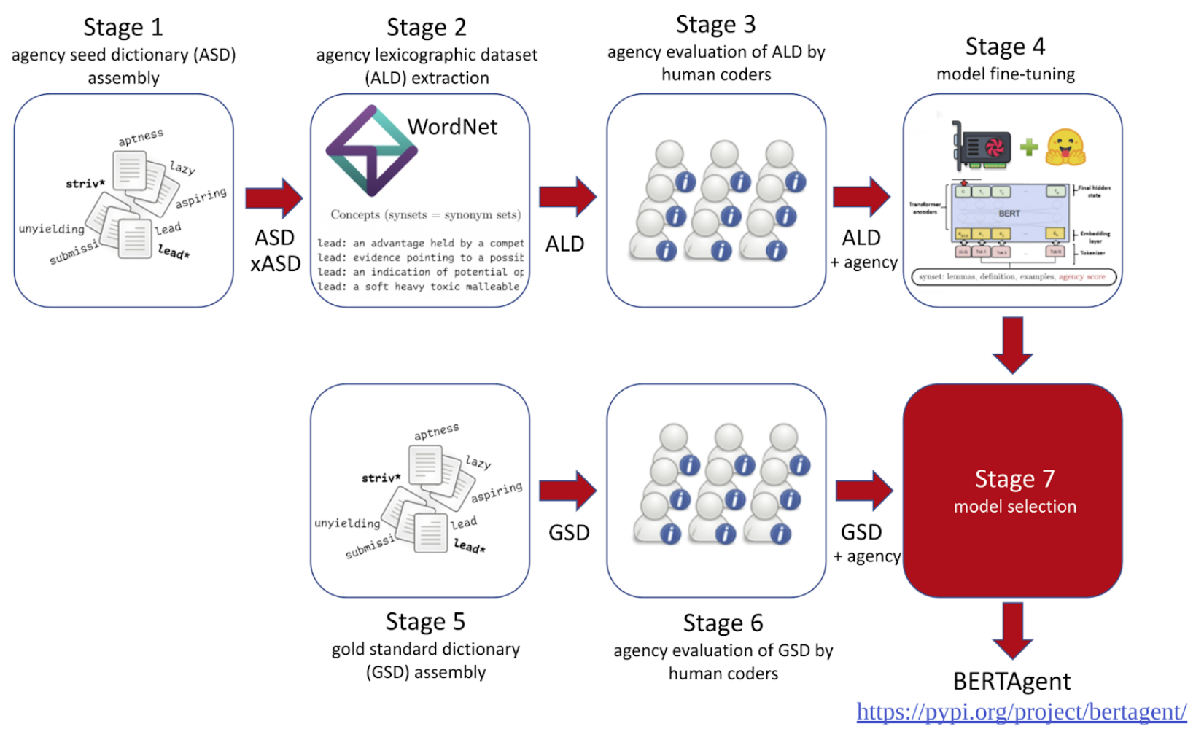

Slide 79
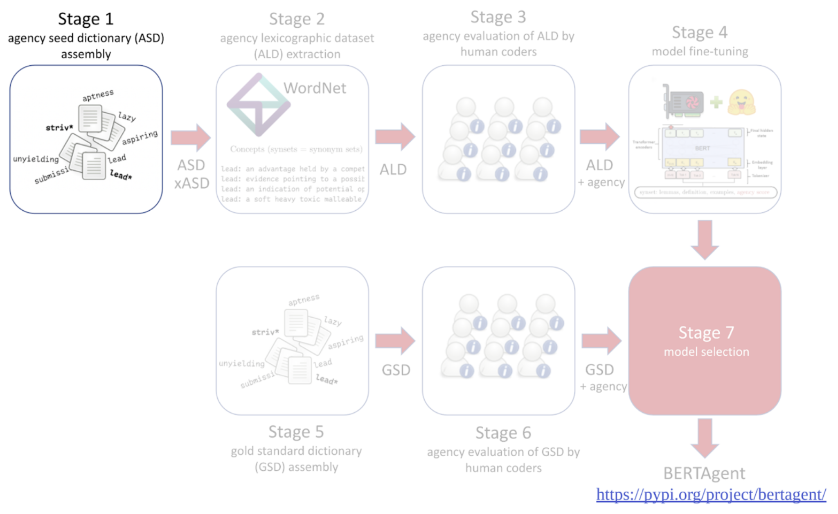

Slide 80
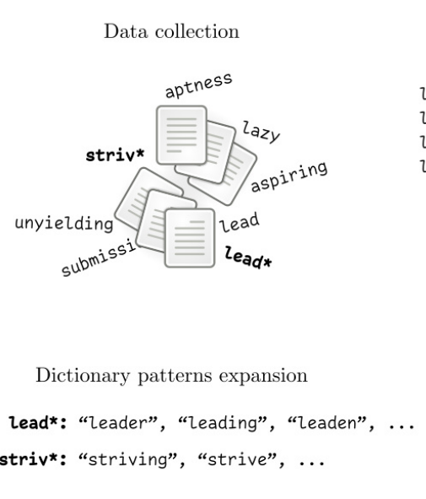

Slide 81
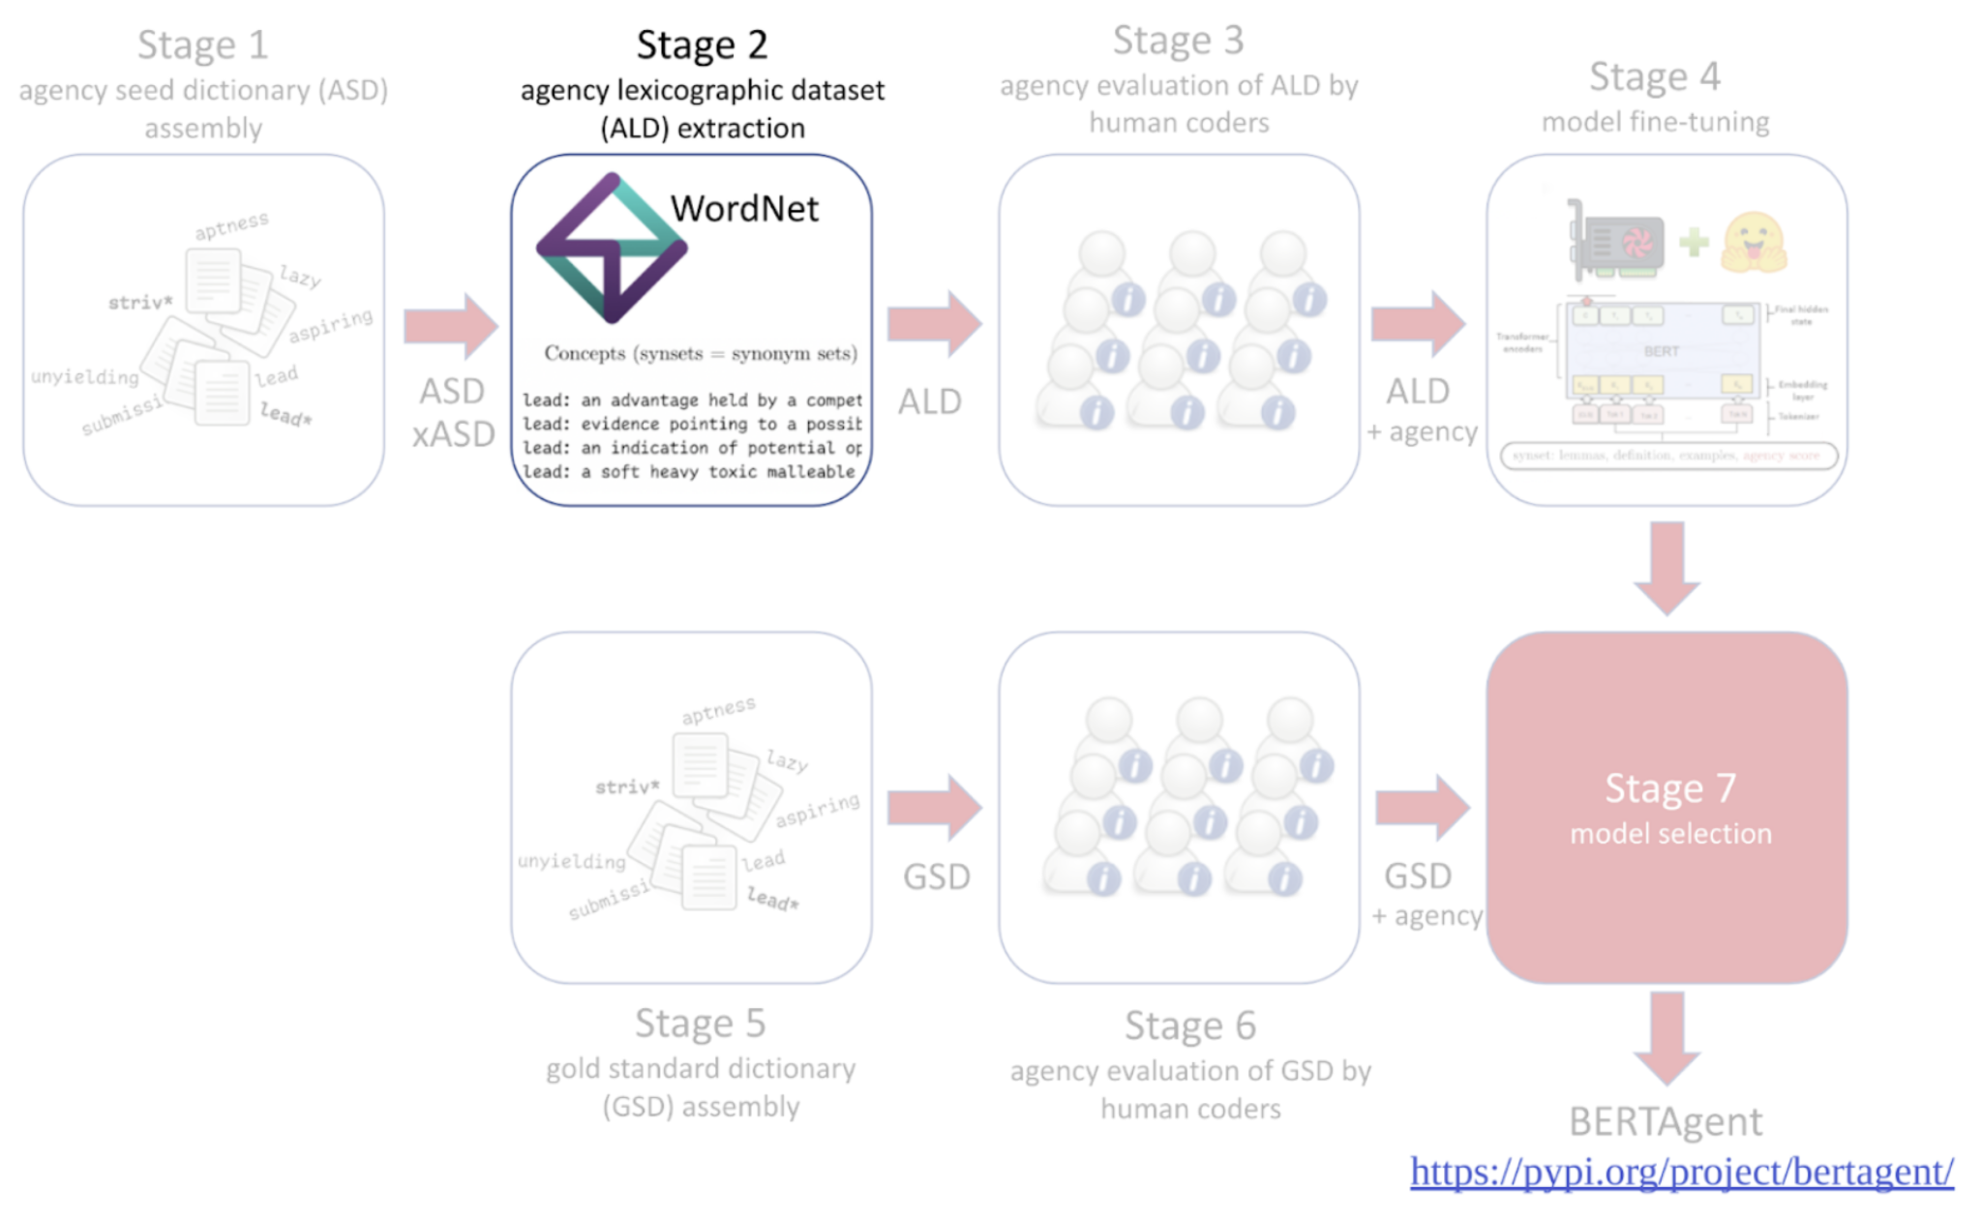

Slide 82
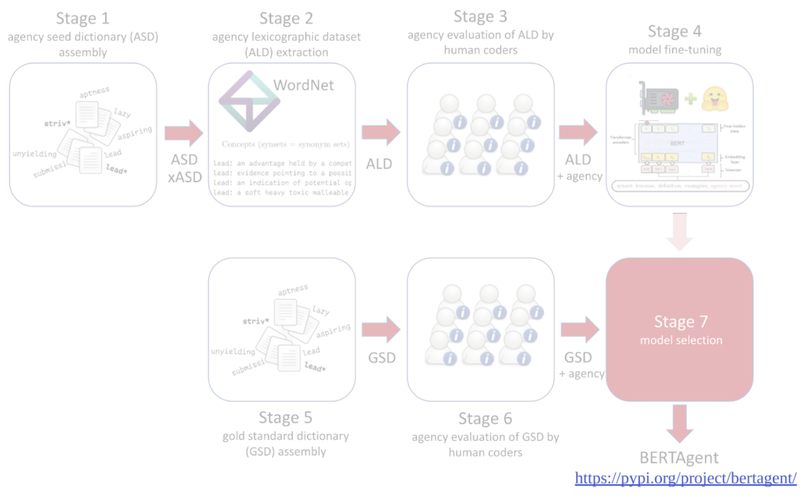
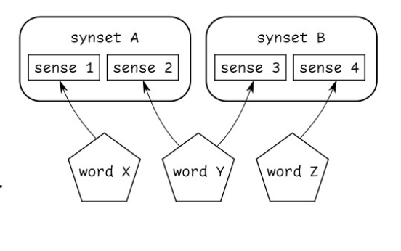

Slide 83
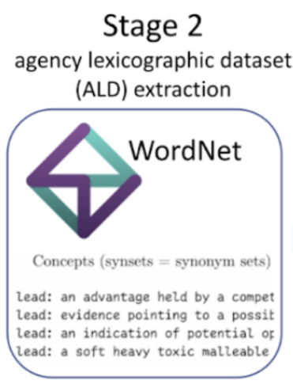

Slide 84
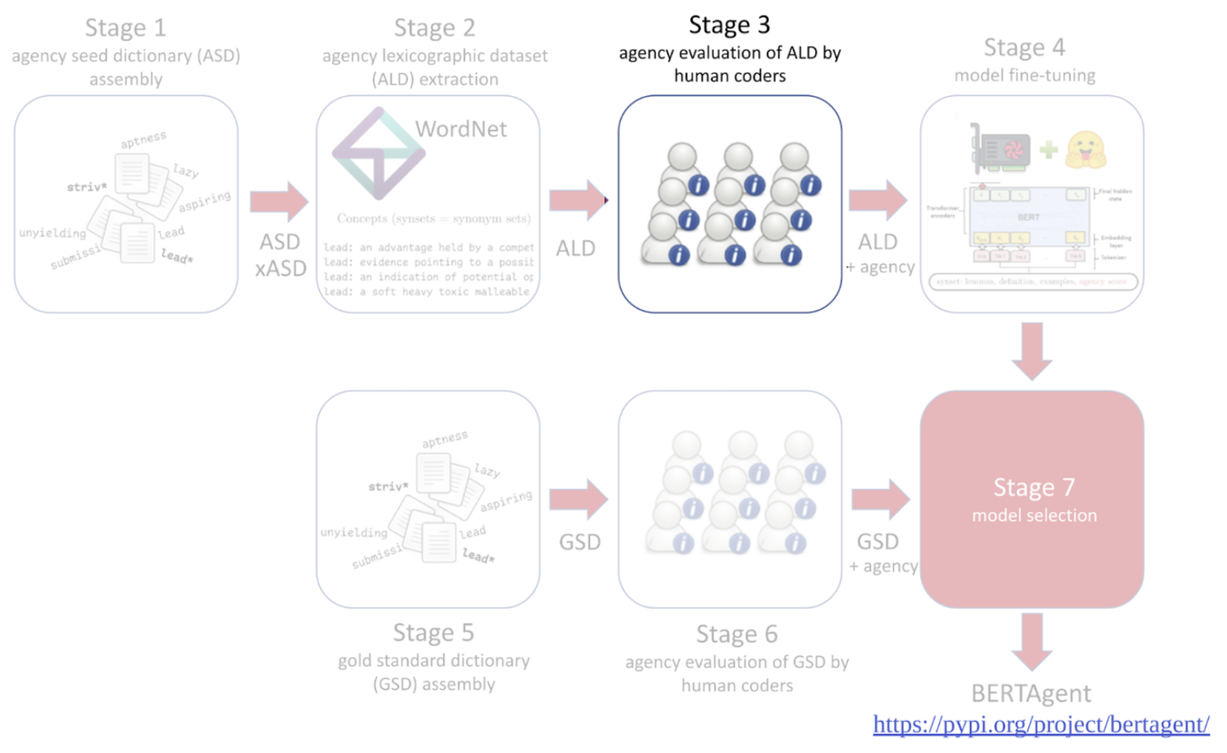

Slide 85
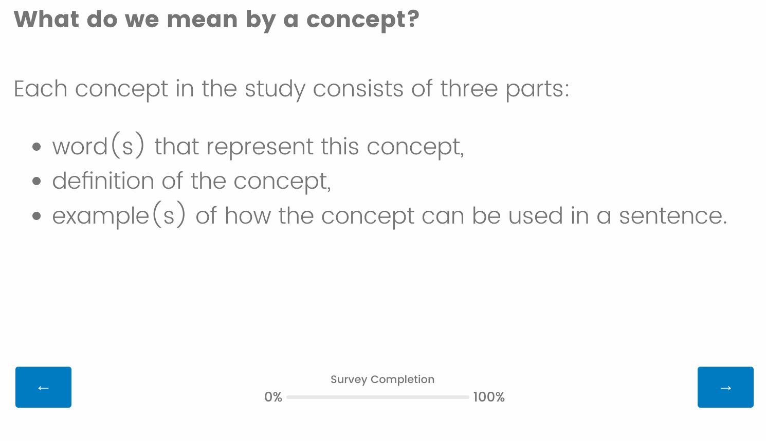

Slide 86
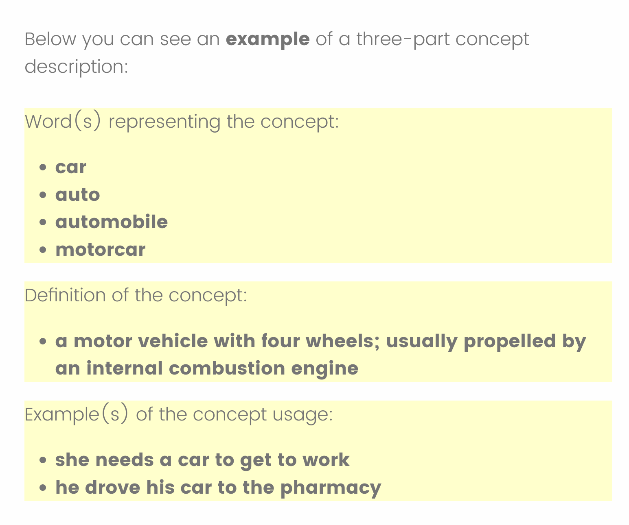

Slide 87


Slide 88


Slide 89


Slide 90


Slide 91


Slide 92


Slide 93
participants were asked to write stories in which they (or somebody they know) were (was) “able to achieve their goal,” “active,” “unsuccessful,” or “lazy”
we randomly selected 960 sentences stratifying conditions (320 sentences per condition).
Sentences labeled them with respect to conveyed agency (-1=negative, 0=not related, 1=positive).

Slide 94


Slide 95
Each of the 90 participants evaluated 100 sentences,
900 evaluations
each of 300 sentences was evaluated by approximately 30 participants

Slide 96


Slide 98
First Test (sanity check)
Text | PietA | PietB | NicoCom | BATot
She is a hardly working individual | 0.00 | 0.00 | 0.33 | -0.62
She is a hard working individual | 0.00 | 0.00 | 0.33 | 0.48
They are striving to achieve their goals | 0.43 | 0.14 | 0.29 | 0.65
They are struggling to achieve their goals | 0.43 | 0.14 | 0.29 | -0.63
They are struggling to survive | 0.20 | 0.00 | 0.20 | -0.44
They are unable to survive | 0.00 | 0.00 | 0.00 | -0.61
This thing was made of lead | 0.17 | 0.17 | 0.00 | -0.04
This car runs on gasoline with lead | 0.00 | 0.14 | 0.00 | -0.02
This car runs on gasoline and it will lead us | 0.10 | 0.10 | 0.10 | 0.09
This politician runs for office and he will lead us | 0.10 | 0.10 | 0.10 | 0.58

Slide 99
First Test (sanity check)
Text | PietA | PietB | NicoCom | BATot
motivated | 1.00 | 0.00 | 1.00 | 0.72
We are motivated | 0.33 | 0.00 | 0.33 | 0.70
We are not motivated | 0.25 | 0.00 | 0.25 | -0.80
We are unmotivated | 0.00 | 0.00 | -0.33 | -0.48
Lazy and unmotivated | 0.00 | 0.00 | -0.67 | -0.85
I want to give up | 0.00 | 0.00 | 0.00 | -0.49
lost all hope | 0.00 | 0.00 | 0.00 | -0.57
We'll lose anyway | 0.00 | 0.00 | 0.00 | -0.43
We should give up and say nothing | 0.14 | 0.00 | 0.00 | -0.41
We must win | 0.33 | 0.00 | 0.00 | 0.65

Slide 100
First Test (sanity check)
Text | PietA | PietB | NicoCom | BATot
motivated | 1.00 | 0.00 | 1.00 | 0.72
We are motivated | 0.33 | 0.00 | 0.33 | 0.70
We are not motivated | 0.25 | 0.00 | 0.25 | -0.80
We are unmotivated | 0.00 | 0.00 | -0.33 | -0.48
Lazy and unmotivated | 0.00 | 0.00 | -0.67 | -0.85
I want to give up | 0.00 | 0.00 | 0.00 | -0.49
lost all hope | 0.00 | 0.00 | 0.00 | -0.57
We'll lose anyway | 0.00 | 0.00 | 0.00 | -0.43
We should give up and say nothing | 0.14 | 0.00 | 0.00 | -0.41
We must win | 0.33 | 0.00 | 0.00 | 0.65

Slide 101


Slide 102
Validation studies (4)
Study 1: Comparison of available tools on the agency GSD; Sourced from an unpublished study by Formanowicz, Nikadon, & Suitner, 2022 and evaluated by human coders
Study 2: Correlations with human evaluations of job occupations; Sourced from Imhoff et al. (2018)
Study 3: Correlations with human evaluations of supernatural concepts; Sourced from Sommer et al. (2022)
Study 4: Discriminant power on inform vs. mobilize others to act. Sourced from an unpublished study by Formanowicz, Beneda et al. (2022)

Slide 103
Validation studies (4)
Study 1: Comparison of available tools on the agency GSD; Sourced from an unpublished study by Formanowicz, Nikadon, & Suitner, 2022 and evaluated by human coders
Study 2: Correlations with human evaluations of job occupations; Sourced from Imhoff et al. (2018)
Study 3: Correlations with human evaluations of supernatural concepts; Sourced from Sommer et al. (2022)
Study 4: Discriminant power on inform vs. mobilize others to act. Sourced from an unpublished study by Formanowicz, Beneda et al. (2022)

Slide 104


Slide 105
Example Application:
2020 U.S. Congressional Election Tweet Data
Election is a type of collective action.
Agency may play an important role in its development and unfolding
Politicians may align their language with their persuasive goals
Use of agentic language
enhances perceptions of the speaker's agency, thereby boosting the perceived effectiveness of the campaign (Formanowicz et al., 2021)
might also function as a catalyst for action orientation among constituents, effectively serving as a tool for mobilization

Slide 114
Agency is also prevalent in commercial setting…

Slide 118


Slide 119


Slide 120


Slide 123
Example Application:
2020 U.S. Congressional Election Tweet Data
Based on the notion that politicians align their language with their persuasive goals we hypothesized that:
The frequency of agentic language use escalated as the election approached (H1) and
… declined afterward (H2),
Agentic communication will increase in before the January 6th Capitol riots (H3)
following Donald J. Trump’s tweet announcing the January 6th rally, presumably with an intention to influence the Electoral College vote count ("Statistically impossible to have lost the 2020 Election. Big protest in D.C. on January 6th. Be there, will be wild!").
Following the Capitol riots - a decrease in agentic language (H4)

Slide 124
2020 U.S. Congressional Election Tweet Data
~ 0.5M original tweets from Democrat (D) and Republican (R) candidates;
180 days prior and after the election;
870 candidates (454 D and 416 R)
1283 Twitter profiles (671 D and 612 R) for ;
Agency was quantified in each tweet using BERTAgent;
A daily average was computed for every candidate.
Notes:
Why agency is relevant for elections (mobilization)

Slide 126
Notes:
KEEP ONLY ELECTION AND JAN 6th (VERTICAL LINES)
HIDE RIGHT HAND SIDE

Slide 128
Modelling of agency dynamics during election cycle
Agency ~ Time * Period + (Time | Name)

Slide 130
Modelling of agency dynamics during election cycle
Agency ~ Time * Period * Outcome + (Time | Name)

Slide 133
Concussions Conclusions
We successfully developed and validated BERTAgen using a combination of:
existing trait-related datasets,
lexicographical data (WordNet),
human coder evaluations,
LLM (RoBERTa).
We captured the temporal dynamics of linguistic agency in real data produced by 2020 U.S. Congressional Election candidates.

Slide 134
BERTAgent: Online resources
Preprint: https://psyarxiv.com/qw6u3/
SOM is available at https://github.com/cogsys-io/BERTAgent-SOM/
Installation from https://pypi.org/project/bertagent/
pip install bertagent
Documentation + tutorial: https://bertagent.readthedocs.io/
Source code: https://github.com/cogsys-io/bertagent/

Slide 136
Thank you!

Slide 137
Bonus Slides ↓

Slide 138
Gold Standard Dataset
participants were asked to write stories in which they (or somebody they know) were (was) “able to achieve their goal,” “active,” “unsuccessful,” or “lazy” (i.e., the first two conditions aimed to induce agency-positive utterances and the remaining two - agency-negative utterances). From these texts, we randomly selected 960 sentences stratifying conditions (320 sentences per condition). Next, authors prescreened these sentences for quality issues (removing very short or poor quality utterances), and labeled them with respect to conveyed agency (-1=negative, 0=not related, 1=positive).
Each of the 90 participants evaluated 100 (randomly assigned to them) sentences, producing together 900 evaluations, each of 300 sentences was evaluated by approximately 30 participants.

Slide 139
ICCs for evaluations by human coders
Synsets
We also used a multi-level model with a random intercept and the evaluated item (synset) as a fixed effect to assess the reliability of the evaluations using two forms of intraclass correlation coefficient (ICC; Muraki et al., 2022; Brysbaert, 2019). For the average correlation of synset evaluations between participants ICC was 0.43.
For the reliability of the average evaluations ICC was 0.85, indicating good reliability (Koo & Li, 2016).
GSD
We assessed the reliability of human evaluations of sentences using two ICCs. For the average correlation of synset evaluations between participants ICC was 0.72. For the reliability of the average evaluations ICC was 0.98, indicating excellent reliability.

Slide 141


Slide 142


Slide 143


Slide 144


Slide 145

Study 5: Discriminant power on inform vs. mobilize others to act

Slide 146


Slide 147


Slide 148
How to use BERTAgent on DFs: An ultra brief tutorial
BERTAgent I/O:
Input: List of sentences
Output: List of agency scores (for each sentence)
Can be easily aggregated using, for example:
Mean
Min
Max
Sum of all values
Sum of positive only values
Sum of negative only values
Sum of absolute values

Slide 149


Slide 150


Slide 151


Slide 152


Slide 153


Slide 154

Note. RMSE = root mean square error; All training datasets contain text snippets derived from agency-related concepts that were extracted from the Open English WordNet (OEWN; McCrae et al., 2021) and evaluated by human coders with respect to agency conveyed. FT0 contains only concept usage examples; FT1 additionally contains lemmas concatenated with definitions; FT2 contains additional augmented data that was derived using antonym relations form OEWN; FT3 was an exploratory approach in which for each concept we combined all its lemmas, definition and all its usage examples; rFT3 is an extension of FT3 to fully include more advanced forms of negation in the training data as described in Section Model updating (re-fine-tuning).

Slide 155


Slide 156


Notes:
HIDE RIGHT HAND SIDE

Slide 157
Further exploratory analyses can be found at: https://cogsys.io/temp/n0001-init.html
https://cogsys.io/temp/scatter_batch_0021_GAUSS_2.html
https://cogsys.io/temp/scatter_batch_0021_GAUSS_4.html

Slide 158
Collective Action
any action aiming to improve the status of an entire group rather than of few individual members of that group (Van Zomeren & Iyer, 2009; also see: van Zomeren, Postmes, & Spears, 2008).

Slide 159
Concussions
We successfully developed and validated BERTAgen using a combination of:
existing trait-related datasets,
lexicographical data (WordNet),
human coder evaluations,
LLM (RoBERTa).
We captured the temporal dynamics of linguistic agency in real data produced by 2020 U.S. Congressional Election candidates.

